Slide 1


Welcome to Owls class
Our teacher is Mrs Driscoll.
Mrs Turner is our class TA.

Slide 2
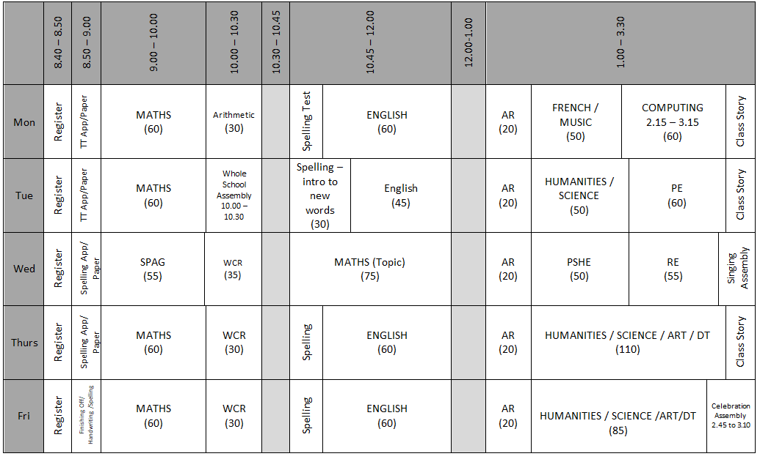
Timetable of the Day

Slide 3

English
In English, we will use a wide range of high-quality texts, chosen by ‘The Literacy Tree’ scheme, to engage pupils and develop their reading and writing skills across the course of the year. Some of these texts may also link to our topic work, for example the book that we began reading last week is ‘Can we save the tiger?’ by Martin Jenkins, which links well with our Humanities work on the rainforest.

Slide 4
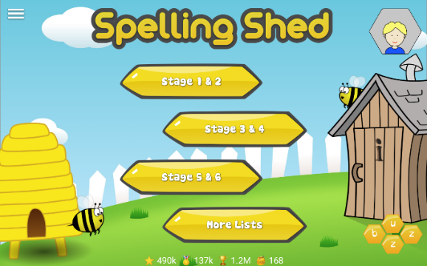

English - Spellings
We will be using Spelling Shed our spelling programme. They will have a 30-minute lesson every Tuesday which will focus on a spelling rule or pattern, followed by a range of spelling activities during the week linked to the spelling rule or pattern being studied. ​
There will be a weekly spelling test every Monday. A list of the spelling rules/patterns which we will study during the term is available on the class page of the school website for your information as I am aware that sheets can sometimes not make it home!
Pupils all have a Spelling Shed account and will have access to the online games which will support them in strengthening their recall. The log in for this can be found in the front of their yellow reading record.
A Parent Guide is available here: https://play.edshed.com/en-gb/login

Slide 5


Accelerated Reader
Please make sure you are signed up to HOME CONNECT. If you need support with this, let us know.
Please enable “Email Notifications” so you can see how your child scores on their quizzes.
All pupils need to bring in their AR book and reading record every day. We have time dedicated to reading every day.

Slide 6

Why Reading is Important
Builds focus and attention – improves concentration and ability to stay engaged for longer.
Boosts knowledge and confidence – the more children read, the more they know, and this builds self-esteem.
Expands vocabulary and communication – avid readers learn new words in context, making it easier to express themselves.
Raises achievement – strong reading habits support success across all areas of the curriculum.
Stimulates creativity and thinking – reading challenges the brain, sparks imagination, and develops new ways of thinking.
Improves spelling naturally – seeing words repeatedly reinforces correct spelling.
Encourages empathy and cultural awareness – books open up new worlds, ideas, and perspectives on people, places, and beliefs.

Slide 7


Maths
Maths homework is not formally set. However, all children are encouraged to practise their times tables recall using TT Rockstars.
SATs Homework
From Spring term onwards, there will be weekly maths and English homework to help year six pupils prepare for their SATs test in May. The homework will include test-style questions and will enable them to revise their understanding of work covered in years three to five, as well as new knowledge gained during year six. More details will be given closer to the time.

Slide 8
Topics
 | Autumn |  | Spring |  |  | Summer
Humanities | Explorers – looking at North and South America with a focus on the Amazon rainforest and then the Mayan civilisation |  | Inventors and Industry – a local history study looking at the Victorian era, including the work of Charles Dickens |  |  | All Change – Finding out about Dawin’s voyage to the Galapagos Islands
Science | Light | Electricity |  | Animals, including humans | Living things and their habitats |  | Evolution and inheritance
DT / Art | Working with colour Electrical Systems – steady hand game |  | Printing Structures - Playgrounds |  |  | Textiles Mechanical Systems - toys
PE | Hockey Gymnastics |  | Handball Tag Rugby |  |  | Rounders Athletics

Slide 9

PE
Our PE day this year is TUESDAY. Should this need to be changed, you will be notified in advance.
Please make sure your child is wearing the correct PE kit:
T-shirt in house colour (Twist, Copperfield, Peggotty or Pip)
Fleece in house colour or black hoodie
PE shorts in green/black
Jog bottoms or legging in black only
No logos on any items of clothing- please wear plain black only
Earrings and watches to be removed and hair tied back.

Slide 10

External tests
Children in year six will sit the Key Stage 2 statutory tests (often called SATs). The dates of these are set by the government.
The statutory key stage 2 tests are timetabled from Monday 10th May to Thursday 13th May 2027.
During SATs week, we offer a breakfast club which we encourage all year six children to come along to. This will be free of charge and will give the children the opportunity to support each other in the run up to the test, help alleviate anxiety and enable children to be in school and ready for the tests each day. More details will be sent out closer to the time.

Slide 11

What they need to bring each day
Reading book and Reading Record Book (yellow A5 book)
Named water bottle (not big Stanley ones!) – they can refill them regularly
All clothing named clearly – bags not too big (need to fit in lockers!)
Snack in a named pot
Fresh fruit – prepared and ready to eat
Fresh vegetables – prepared and ready to eat
Plain breadsticks (nut / sesame seed free) – out of their wrapper and in a named snack pot.
Pitta bread or other bread – out of their wrapper and in a named snack pot.

Slide 12
How to support your child at home
Helping with homework – learning spellings (issued every Tuesday) and times tables
Hearing them read regularly and asking them questions about what they have read
Talk to them about school – What new facts did they learn today? What did they find tricky?
Help them find other information / go on visits linked to the topics being studied.
Keep an eye on the school website and Facebook pages for information about the different events in school and for other useful information

Slide 13
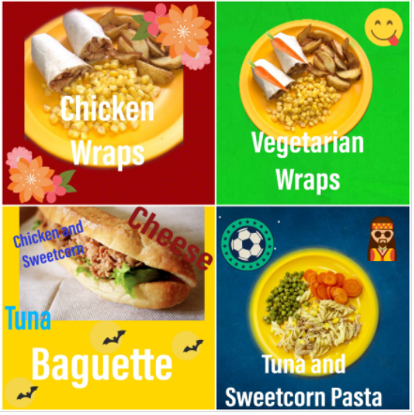
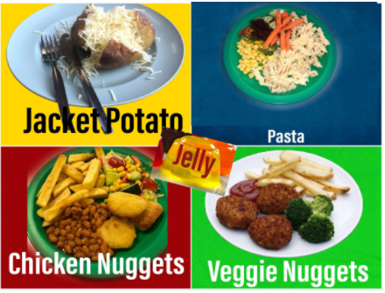
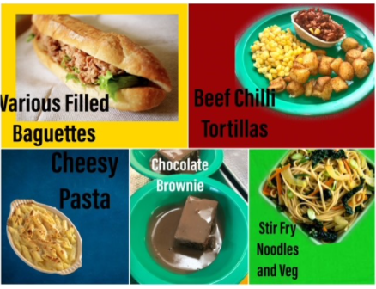
Lunch
Don’t forget to try our tasty school dinners
Menus are available on the school website
Please wherever possible, order you child’s meal in advance on Bromcom as this makes morning registration much quicker

Slide 14
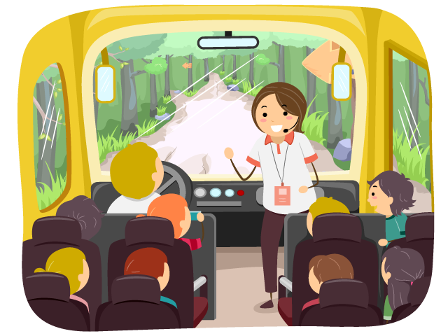
School Trips and Events
School trips and workshops have not been finalised for this year yet, however I will try to give you as much notice as possible. I have already booked in a cinema trip in November – free tickets!
Enterprise week will take place at the end of term 5 – the money raised from this is used to fund the post-SATS activities and Leavers BBQ

Slide 15
Thank you for coming.
Do feel free to ask questions.
Alternatively, an email can be sent to the school office who will pass on any queries.
This presentation will be available on the Owls class page of the school website.

