Slide 1


Welcome to Foxes class
Our teacher is Miss Davey.

Slide 2
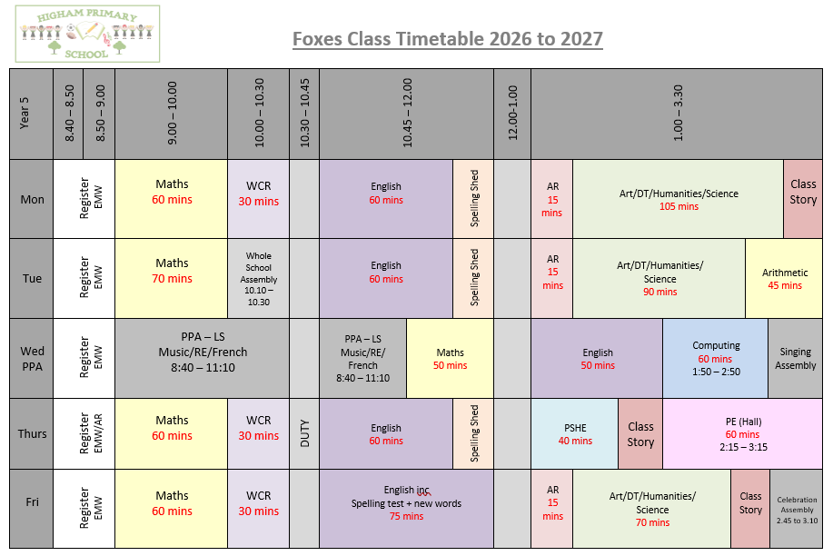
Timetable of the Day

Slide 3


English
In term 1, the children will work on the texts, ‘Hidden Figures’ and ‘Robot Girl’ to generate their own writing across a range of genres, including descriptions, non-chronological reports, diary entries, character comparisons, letters of advice and narrative writing.

Slide 4
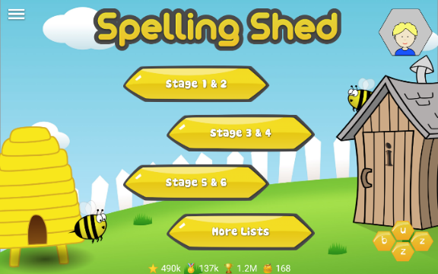
English - Spellings
This year, Foxes class will continue to use Spelling Shed as their spelling programme. They will have a 30-minute lesson every week which will focus on a spelling rule or pattern, followed by daily spelling activities linked to the spelling rule or pattern being studied. ​
New spellings will be given every Friday and tested the following Friday. A list of the spelling rules/patterns which we will study during the year, along with exemplar words, will be available on the class page of the school website for your information.
You will also find the weekly Spelling Shed homework as well as year 3/4 and 5/6 statutory spelling word lists on our class page. The first set of words, and accompanying homework, will be given out on Friday 11th September with the first spelling test taking place on Friday 18th September.
Pupils all have a Spelling Shed account and will have access to the online games which will support them in strengthening their recall.
Notes:
4

Slide 5

Accelerated Reader
Please sign up to HOME CONNECT using the link provided on the letter which was sent home on Friday 11th September. If you need another copy, let us know.
Please enable “Email Notifications” so you can see how your child scores on their quizzes.
All pupils need to bring in their AR book and reading record every day. We have time dedicated to reading every day.

Slide 6

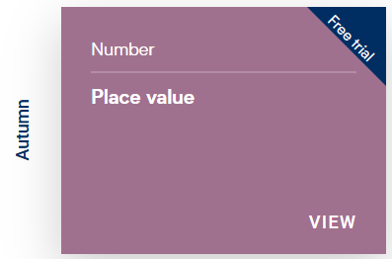
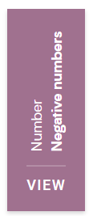
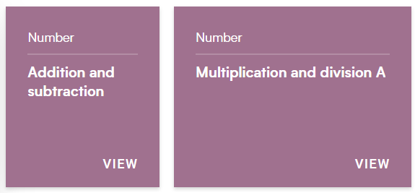
Maths
Maths homework is not formally set. However, all children are encouraged to practise their times tables recall using TT Rockstars.
We use White Rose as the basis for our Maths lessons.
This term we will be looking at place value, negative numbers, addition and subtraction and multiplication and division.

Slide 7


Topics
In term 1 and 2, our humanities topic will be ‘Meet the Greeks’.
The children will take a trip back to one of the most fascinating civilisations in history as they discover Ancient Greece. They will discover the people, the inventions, the art, the technology, the mythology and much more. Children will need to use their research skills to investigate what daily life was like for the Ancient Greeks, focusing on a range of aspects such as food, clothing, education and what life was like in differing city states. The children will study the origin of the Olympic Games and how it compares to the Olympics of today.
They will also extend their existing knowledge of Europe by studying the country of Greece, identifying some key physical and human characteristics, and major cities in both ancient and modern Greece.

Slide 8
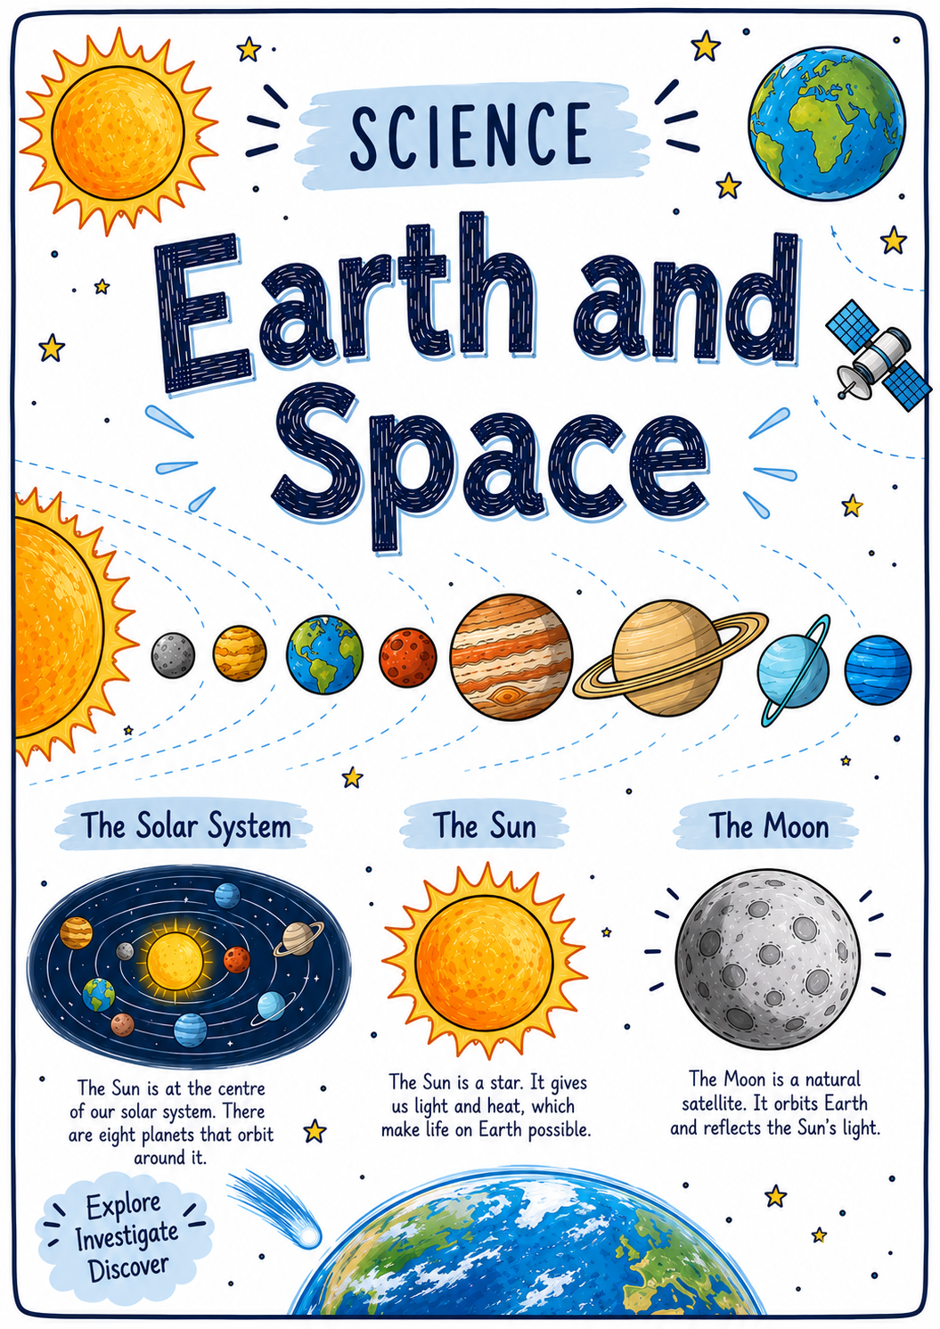
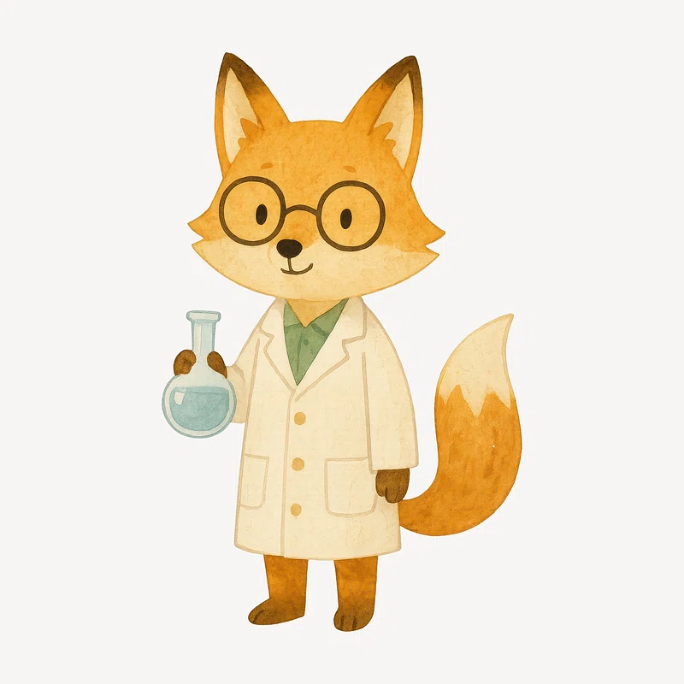
Topics
Our science work this term focuses on ‘Earth and Space’.
Children will develop an understanding our solar system, the movement of celestial bodies, and how Earth's rotation creates day and night.
They will also learn that the Sun, Earth, and Moon are approximately spherical and explore how science explains our place in space.

Slide 9

PE
Our PE day this year is Thursday. Should this need to be changed, you will be notified in advance.
Please make sure your child is wearing the correct PE kit:
T-shirt in house colour (Twist, Copperfield, Peggotty or Pip)
Fleece in house colour or black hoodie
PE shorts in green/black
Jog bottoms or legging in black only
No logos on any items of clothing- please wear plain black only.

Slide 10
Cooking
As part of our Design Technology curriculum, all of the children will get the opportunity to take part in cooking lessons with Mrs Harryman in the kitchen.
The children will not all go at the same time and may not cook until the end of the year. The children will be split into groups and each group will attend five sessions across the term. This will begin from term 2 and you will be notified at least two weeks before your child is due to begin cooking lessons.
When it is your child’s turn, you will receive a letter with all the details. In order to cover the cost of the ingredients, we are asking for a contribution of £5 per child. This only needs to be paid when it is your child’s turn.
They will also need to bring in an airtight box each week to take home their cooking.

Slide 11
What they need to bring each day
Reading book and Reading Record Book (yellow A5 book)
Named water bottle
All clothing named clearly
Snack in a clearly named pot. Snacks must be prepared and removed from any packaging.
  Fresh Fruit
  Fresh Vegetables
  Dried Fruit (plain, no toppings or coatings)
  Plain Breadsticks (nut/sesame seed free)
  Cream Crackers
  Bread - White/Brown Bread, Pitta, Bagel ONLY (nut/sesame seed free)
Please note that only butter or margarine is allowed as a topping on bread and cream crackers.

Slide 12
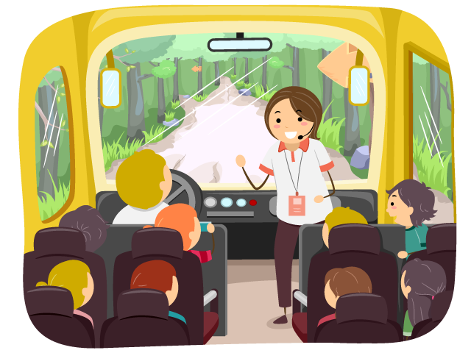
School Trips and Events
School trips and workshops have not been finalised for this year yet; however we aim to give you as much notice as possible.
Swimming takes place for Y5 in the Spring term. We will go to Cobham Hall each week where the children have a lesson taught by qualified swimming instructors. More details to follow.
PGL (Wednesday 28th April – Saturday 1st May 2027) There will be a meeting nearer to the time to go over the arrangements for this.

Slide 13
How to support your child at home
Helping with homework – please support your child to practise their times tables using TT Rockstars and their Spelling Shed spelling words.
The importance of hearing your child read, even when they are an independent reader, cannot be overstated. Reading aloud helps to develop an understanding of appropriate tone and volume as well as closely observing punctuation in the text. Discussing what they have read helps build the skills of inference, deduction and prediction.
Strengthening reading fluency and comprehension can also have a positive impact on writing. Reading and writing draw upon the same skills, knowledge, and processes in terms of being able to read and comprehend text and in terms of being able to write text.

Slide 14

Why Reading is Important
Builds focus and attention – improves concentration and ability to stay engaged for longer.
Boosts knowledge and confidence – the more children read, the more they know, and this builds self-esteem.
Expands vocabulary and communication – avid readers learn new words in context, making it easier to express themselves.
Raises achievement – strong reading habits support success across all areas of the curriculum.
Stimulates creativity and thinking – reading challenges the brain, sparks imagination, and develops new ways of thinking.
Improves spelling naturally – seeing words repeatedly reinforces correct spelling.
Encourages empathy and cultural awareness – books open up new worlds, ideas, and perspectives on people, places, and beliefs.

Slide 15
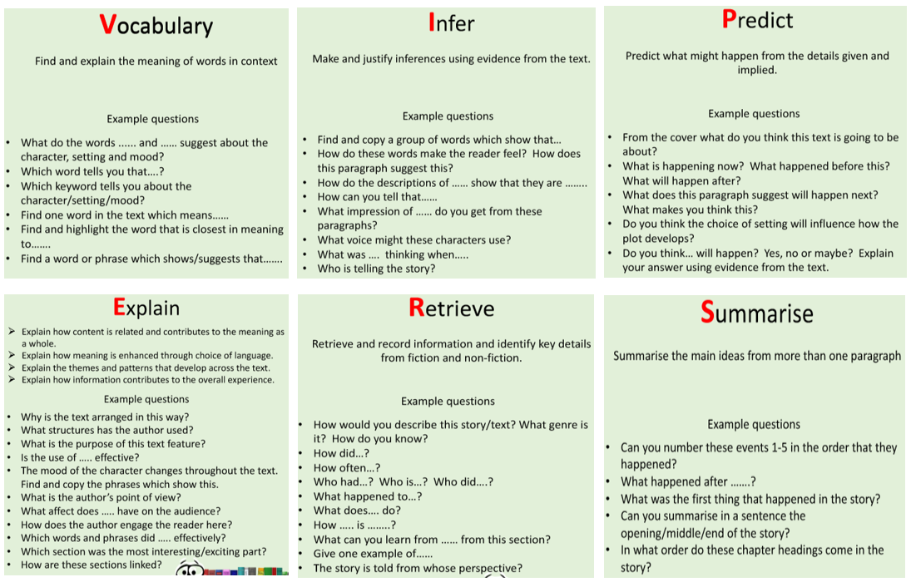
Questions you can ask at home…

Slide 16
Thank you for coming.
Do feel free to ask questions.
Alternatively, an email can be sent to the school office who will pass on any queries.
This presentation will be available on the Foxes class page of the school website.

