Slide 1

Welcome to Squirrel’s class
Your teacher is Miss Garrett.
Your teaching assistants are Mrs Capon and Miss Harmon.

Slide 2
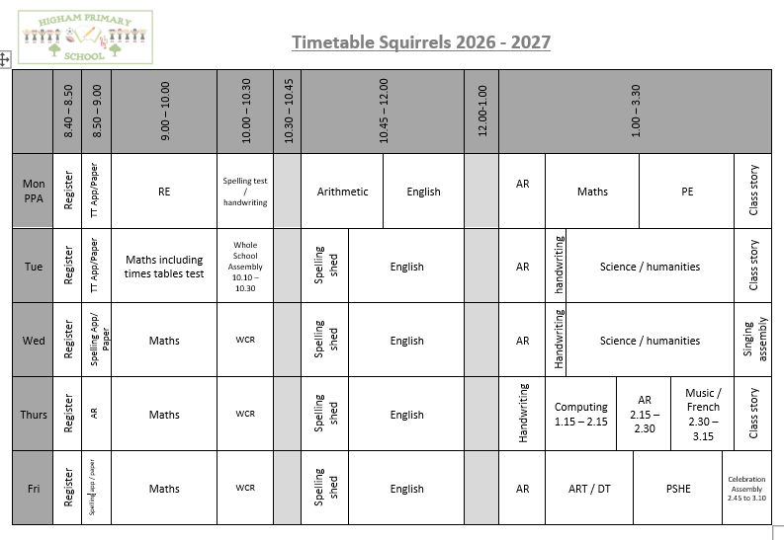

Slide 3

English
In writing, we will focus on the following key texts and writing outcomes:
The Barnabus Project – Brochure to advertise a new pet shop
The Seed of Doubt – Motivational leaflet to inspire children to follow their dreams
Small in the City – Narrative from perspective of cat
Cloud Tea Monkeys – Non-chronological report about fair trade
Each text will also provide opportunities for children to write across a range of fiction, poetry and non-fiction genres. Grammar and punctuation will be taught within this context, enabling pupils to apply their skills in meaningful and purposeful writing.
In reading, we will explore a range of high-quality texts to develop children’s enjoyment and understanding of literature. Pupils will strengthen their comprehension skills in vocabulary, inference, prediction, explanation, retrieval and summarising, through approaches such as VIPERS.
Spelling Shed will be used to teach spellings patterns and rules
RWI Handwriting will be used to support the development of a joined, legible and fluent handwriting style.

Slide 4


Accelerated Reader
Your child is now using the Accelerated Reader Programme and they may quiz and change their book on any day. However please make sure your child has read and understood the book really well before quizzing.
Please sign up to Home Connect. You will then receive an email each time your child completes a quiz in school and you will also be able to see how they are doing with their reading targets.
All pupils need to bring in their AR book and reading record every day. We have time dedicated to reading every day.

Slide 5
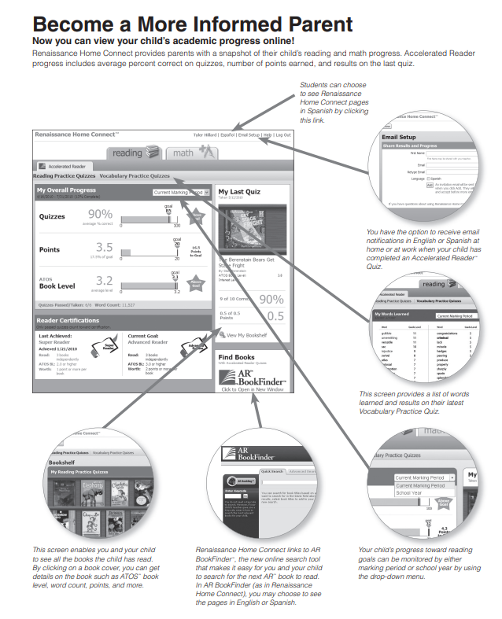
Accelerated Reader
Home Connect – It tells you:
How they got on in quizzes
How many points they have
Their book level
How they are progressing towards their targets

Slide 6
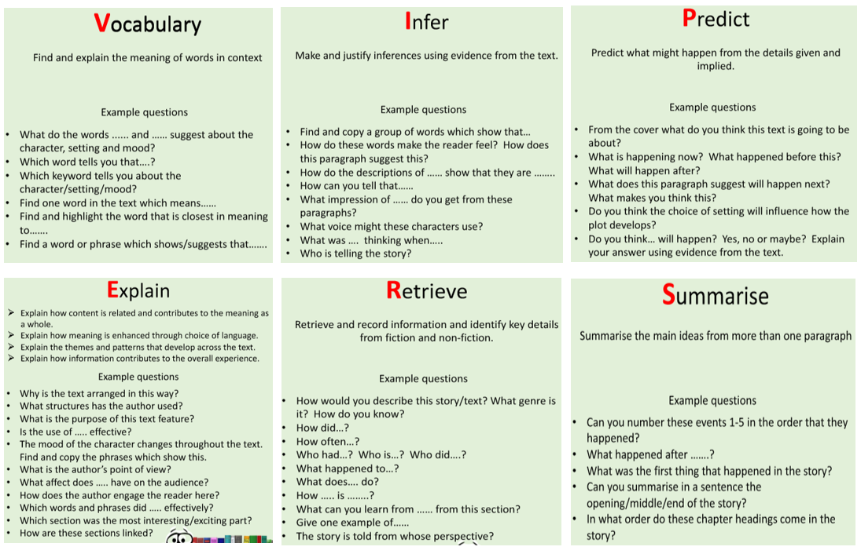
Questions you can ask at home…
What is comprehension?
This refers to the understanding of a text.
There are cases of where children are able to read thanks to secure phonics knowledge and the ability to decode but do not understand what they have read.

Slide 7
What you can do to help develop comprehension…
Comprehension of the world will develop comprehension in reading…
Ways you can develop comprehension –
  Talking a lot at home… about everything
  Develop cultural capital by going out (this does not have to cost money)
  Reading together and discussing books together
    Why do you like this book?
    What do you think will happen next?
    What do you think about this character?

Slide 8

English - Spellings
This year, we will be continuing to use Spelling Shed to teach and practice spellings. They will have a 30 minute lesson every Tuesday which will focus on a spelling rule or pattern, followed by daily spelling activities linked to the spelling rule or pattern being studied. ​
There will be a weekly spelling test every Monday. A list of the spelling rules/patterns which we will study during the term will be made available on the class page of the school website for your information.​
Children also need to continue to practice their common exception words.
Pupils will all have a Spelling Shed account and will have access to the online games which will support them in strengthening their recall.

Slide 9
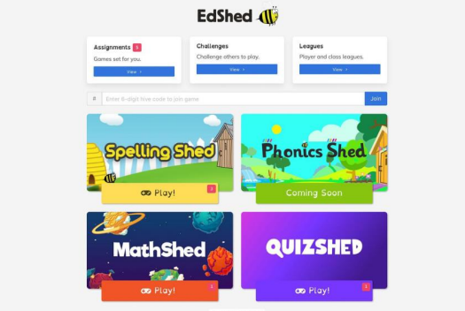
Pupils can log in using the username and password and it will take you to this screen. You do not need to buy the app. You can use spelling shed FREE on a web browser.
The pink notification boxes indicate how many assignments have been set by the teacher and on which game.
If you click on the assignments box at the top of the menu, you can see all of the assignments together.

Slide 10

Maths
TT Rockstars.
Children will have set times tables to work on to become fluent.
All children need to be practising their timetables (using TT Rockstars 3 x a week (10 minutes each time) including Studio levels for speed tests) and their number bonds (using Numbots – if required). Login details can be found in the front of their reading record books.
Children will be having a times tables test on a Tuesday. The children have been given the list of the times tables that they need to focus on for that week. This is also on the school website.

Slide 11
Topics
Time travellers.
During this theme children will explore life during the Stone Age, Bronze Age and Iron Age. They will discover how people lived and the developments of the time such as the use of tools and the different types of housing and settlements. The children will investigate a range of evidence used by archaeologists to understand how we know about a time period so long ago.

Slide 12

PE
Our PE day is Monday.
Please make sure you are wearing the correct PE kit:
T-shirt in house colour (Twist, Copperfield, Peggotty or Pip)
Fleece in house colour or black hoodie
PE shorts in green/black
Jog bottoms or legging in black only
No logos on any items of clothing- please wear plain black only.
(PE bag not required)

Slide 13
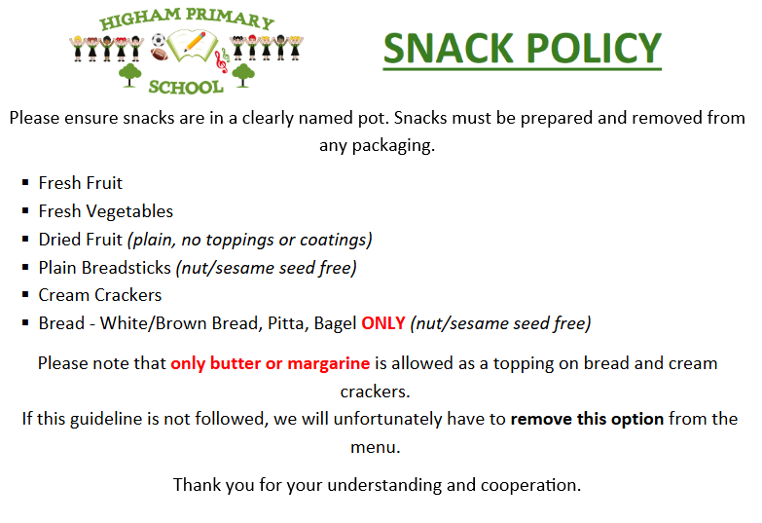

Slide 14
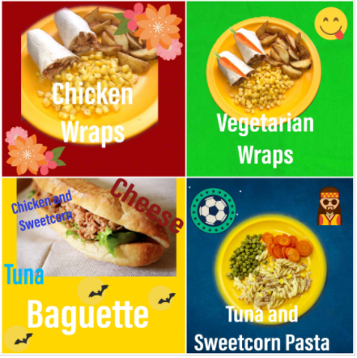
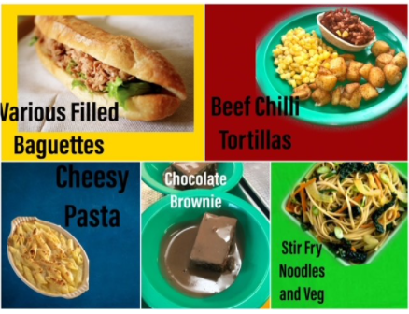
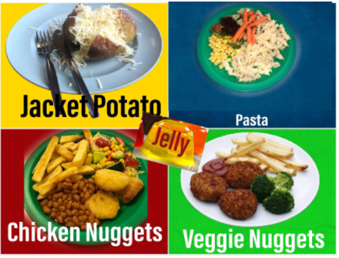
Lunch
Don’t forget to try our yummy school dinners
Menus are on the school website

Slide 15
How to support your child at home
Helping with homework
Hearing them read
Lots of useful information on the School Website
Encouraging them to use TT Rockstars and Spelling shed regularly

Slide 16
What they need to bring each day
Reading book and Reading Record Book
Named Water bottle
All clothing named
Healthy snack (as detailed in the school policy)in a named pot

Slide 17
Volunteers
Can anyone volunteer to help in class?
If you are available and wish to help in class regularly please let the office know so that they can arrange an agreeable time.
As a school we would just ask for a regular commitment from you as we would need to get a DBS completed in order for you to help.

Slide 18
Thank-you for coming
Any questions?

