Slide 1


Welcome to Rabbits class
Your teachers are Mrs Barkel (Monday, Tuesday and Wednesday) and Mrs Levy (Thursday and Friday)
Your teaching assistant is Mrs Defrates and Miss Reece also supports in class.

Slide 2
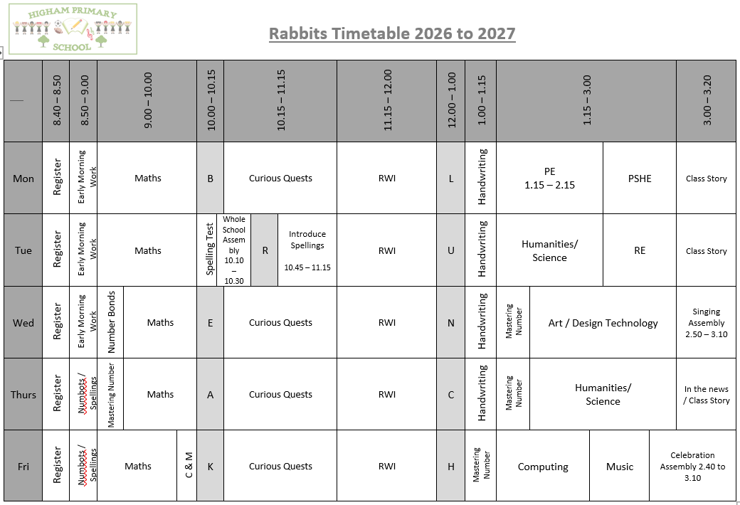
Timetable

Slide 3


English
We are excited for the children to continue their Curious Quests journey in Year 2.
Along the way, they will encounter new characters, undertake exciting quests and explore new adventures that support their English learning.
Using a range of high-quality texts, children will develop their reading, writing, speaking and listening skills through rich discussions, drama and creative writing opportunities.

Slide 4

Phonics – Read Write Inc
RWI will continue to be used to teach phonics.
Please make sure your child watches the short videos that are sent home to further support their phonics.
QR codes are provided so hopefully they are easy to access. Any problems please let me know!

Slide 5
Reading at Home Key Stage 1
Children will take home a decodable reading book that is carefully matched to their phonics knowledge. Books can be changed on Mondays and Thursdays. Please sign the reading record book when a book is ready to be changed and remind them to place their book bag in the book box on these days. All books sent home will be recorded in the reading record.
Children will also take home a paper copy of the RWI book they have read in class (to be kept in a plastic wallet). This is to develop fluency at home as they would already be familiar with the text.
Children will also take home a sharing / reading for pleasure book. This book is for children to share with their parents to help develop a love of reading.
We expect all children to read for between 10 and 15 minutes every evening each school day, and once at the weekend.

Slide 6

English - Spellings
In Year 2, we will use Spelling Shed to teach and practise spellings. Children will have a 30-minute spelling lesson each Tuesday, focusing on a spelling rule or pattern, followed by activities throughout the week to reinforce their learning.
There will be a weekly spelling test each Tuesday.
The term's spelling words and patterns will be available on the class page of the school website.
An optional weekly spelling homework sheet will be sent home to support learning.
All pupils will have a Spelling Shed account, giving them access to online games that help strengthen spelling knowledge and recall.
A parent guide is available here: https://play.edshed.com/en-gb/login

Slide 7
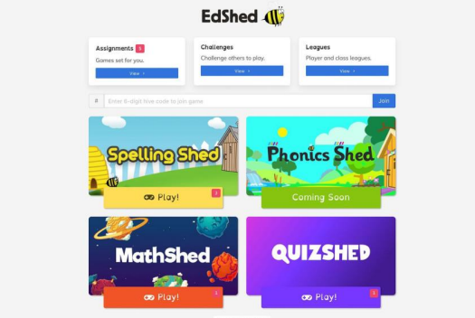
Pupils can log in using the username and password and it will take you to this screen. You do not need to buy the app. You can use spelling shed FREE on a web browser.
The pink notification boxes indicate how many assignments have been set by the teacher and on which game.
If you click on the assignments box at the top of the menu, you can see all of the assignments together.

Slide 8
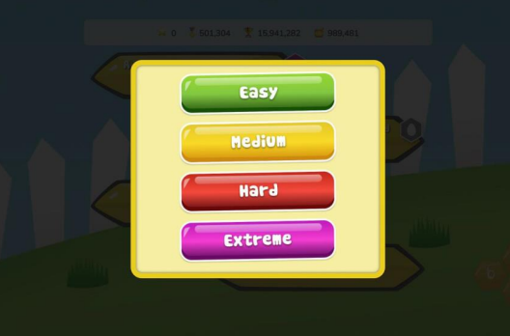
Play
When you click ‘Play’, four difficulty options will appear.
Easy - You will be shown the word as well as hearing it and you will only see the letters you need to spell it.
Medium - You can listen to the word and you will only have the letters you need.
Hard - You can listen to the word but you will have a few extra letters added
Extreme - You will hear the word and you have a full keyboard of letters
These levels of difficulty apply to solo and hive games. Games completed on easier levels will give the player a lower score and lower ranking. The teacher will be able to see which levels have been chosen for each game.

Slide 9
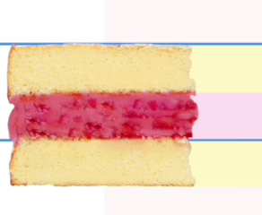
English - Handwriting
In Year 2, we will use RWI Handwriting to teach a mature handwriting style that will flow easily into joined writing.
We use an imaginary sponge cake so children can visualise where to place each letter on the line, the jam in the middle and a layer sponge on the top and bottom.
They will learn two joins: the ‘hill’ join and the ‘bridge’ join.
We teach that all letters are joined with the ‘hill’ or ‘bridge’ join, except for g, j, q, y and z.

Slide 10

Maths
The children continue to have access to Numbots
We expect them to use the programme for at least 15 minutes each week.
The class newsletter has a QR code for a parent guide to Numbots.
Their username and password is in the front of their reading record book.

Slide 11
What are we learning?
Science – Everyday Materials.
We will look at how some materials can be used for more than one thing, and how different materials can be used for the same purpose. We will also think carefully about the properties of materials that make them suitable or unsuitable for particular jobs.
We will investigate how some solid objects can be changed by squashing, twisting, bending, and stretching. As scientists, we will carry out our own tests, compare materials, and record our observations to help us explain what we discover.
Topic – London’s Calling
This term, we will be exploring what makes London the capital city of England today. We will learn about key landmarks, their history, and how to read, use, and make simple maps with keys.
We will then look back in time to investigate what London was like in the past, focusing in detail on the events of the Great Fire of London. We will explore its causes and effects, as well as different accounts of the fire, including the famous diary of Samuel Pepys.
As part of this, we will also revisit our Science learning on materials to consider why the fire spread so quickly and how these events led to important changes in everyday life.
Further information about what we are learning can be found on the school website soon. Please see the class newsletter for links.

Slide 12

PE
Our PE day is Monday.
Please make sure you are wearing the correct PE kit:
T-shirt in house colour (Twist, Copperfield, Peggotty or Pip)
Fleece in house colour or black hoodie
PE shorts in green/black
Jogging bottoms or legging in black only
No logos on any items of clothing- please wear plain black only.
(PE bag not required)

Slide 13
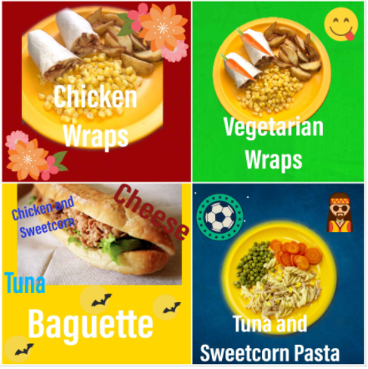
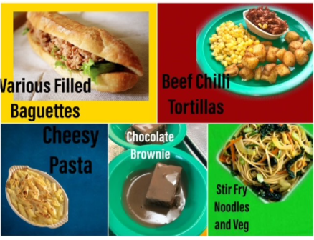
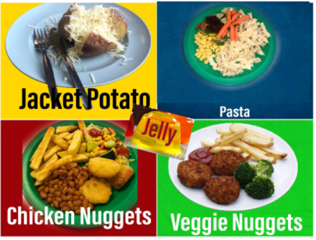
Lunch
Please order your child’s lunch via Bromcom.
Menus are on the school website

Slide 14
How to support your child at home
Helping with homework
Encouraging them to use Numbots and Spelling Shed weekly.
Hearing them read
Help them to practise their Number Bonds and/or Times Tables
Lots of useful information on the School Website

Slide 15
What they need to bring each day
Reading book and Reading Record Book (On Mondays and Thursdays)
Named Water bottle
All clothing named
Snack in a named pot
The snacks allowed in school are as follows:
  Fresh fruit – prepared and ready to eat and in a named snack pot.
  Fresh vegetables – prepared and ready to eat in a named snack pot.
  Dried fruit (plain, no toppings)
  Plain breadsticks (nut / sesame seed free and out of their wrapper and in a named snack pot).
  Cream crackers
  Bread- white/brown bread, pitta or bagel only (nut/ sesame seed free and out of their wrapper and in a named snack pot).
Please note - only butter or margarine is allowed as a topping on bread or cream crackers.

Slide 16
Thank-you for coming
Any questions?
Remember any problems please come and speak to us, so we can sort things out as quickly as possible. We are available at the end of the day (except Wednesday) or email the school office.

