Slide 1



Higham Primary School
Secondary Admissions
Information Evening
4.6.26

Slide 2
Choosing a secondary school….
All secondary schools have an opening evening in Term 1.
Some need to be pre-booked so check with the school you would like to visit. Some start as early as 5pm so be prepared and check in advance on their website.
It is good to visit when in Year 5 and when in Year 6.
If you are not sure contact the school.
Look at as many secondary schools as possible so as to make an informed choice.
If your child is SEN always ask to speak to the SENCO to get a feel for what they can offer.
All secondary schools have an open morning in term 1 – These need to be booked in advance directly with the school.
This gives you an idea of the school in action. Alert us if you intend to visit a school and the absence will be authorised.

Slide 3
Key Action | Scheme date
Registration for testing opens | Monday 1 June 2026
Closing date for registration | Tuesday 1 July 2026 (midnight)
Application for Secondary Transfer opens | Tuesday 1 September 2026
Test date for pupils in Kent Primary schools | Thursday 10 September 2026
Test date for pupils not in Kent Primary schools from | Weekend of 12/13 Sept 2026
Assessment decision sent to parents | Thursday 15 October 2026
National closing date for application forms | Monday 2 November 2026
National Offer Day: e-mails sent after 4pm | Monday 1 March 2027
Schools send out welcome letters no earlier than | Wednesday 3 March 2027
Deadline for late applications and waiting list requests to be included in the Kent County Council reallocation stage. Also the date by which places should be accepted or declined to schools. | Monday 15 March 2027
Deadline for lodging appeals | Tuesday 13 April 2027
Kent County Council to reallocate places that have become available from the schools’ waiting lists. After this point, schools will take back ownership of their waiting lists. | Tuesday 27 April 2027
Key Dates….
Kent

Slide 4
Key dates from secondary school admissions 2027
Date | Event
Registration for the Medway Test (11+) opens. | Monday 18 May 2026
Registration for the Medway Test closes. | Friday 12 June 2026
Closing date for special arrangements requests from schools. | Monday 22 June 2026
Secondary school applications open. | Tuesday 1 September 2026
Medway Test dates for children who attend Medway primary and junior schools. | Tuesday 15 and Wednesday 16 September 2026
Medway Test date for children from non-Medway schools. One day will be allocated to each child who attends a non-Medway primary or junior school. | Saturday 19 September or Sunday 20 September 2026 (you will be allocated one of these dates).
Results of the Medway Test. | Wednesday 14 October 2026
Secondary school applications close. | Saturday 31 October 2026 5pm
Offers sent to parents and carers. | Monday 1 March 2027
Deadline for accepting/refusing offers, waiting requests and appeal requests. | Friday 12 March 2027
Re-allocation of school places and processing of late applications. | Monday 19 April 2027
End of admissions process and waiting lists close. | Tuesday 31 August 2027
Key Dates…
Medway

Slide 5
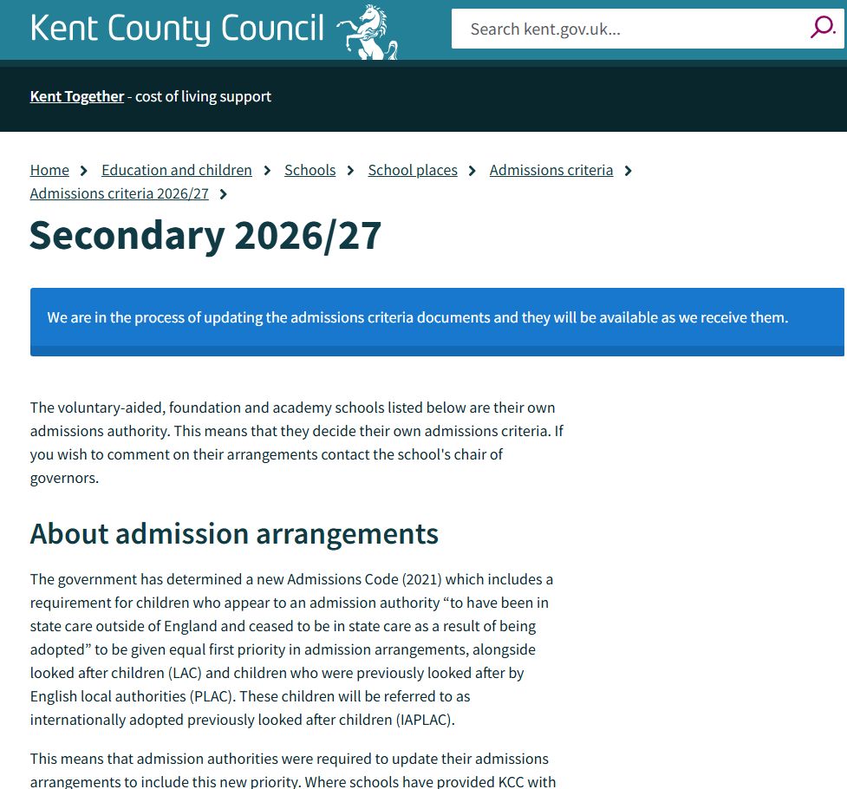

Slide 6
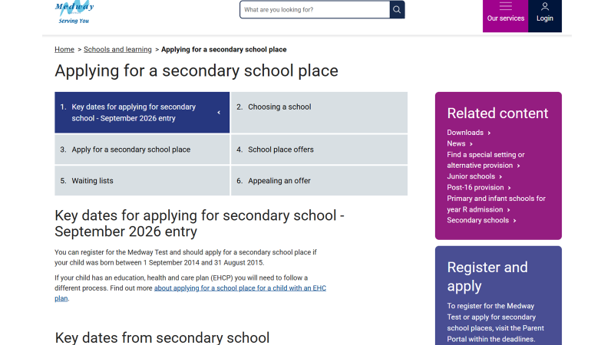

Slide 7
Kent Secondary Common Application Form (SCAF)
Application form opens: Tuesday 1 September 2026
Application form closes: Monday 2 November 2026
Medway Secondary Common Application Form (SCAF)
Application form opens: Tuesday 1 September 2026
Application form closes: Saturday 31 October 2026 (5pm)

Slide 8
Secondary schools:
Every secondary school has an open evening tour between 1st September 2026 and 23rd October 2026.
‘You can apply for up to 4 schools (Kent) and up to 6 schools (Medway), putting them in order of preference. It's in your best interests to list 4 / 6 schools. Naming only one school does not guarantee your child a place at that school or give your child priority for a place over another child, neither does naming a school more than once’.
Choose 4 secondary schools (Kent residents), 6 secondary schools (Medway residents)
Put favourite school first (this affects appeal process)
If possible put a local secondary on your list
If not passed 11+ and plan to appeal ensure that the Grammar school you want is on the form (does not matter where – do not put as first choice! You will not be allocated this)

Slide 9
Warning!!!
When you receive your offer of a secondary school on 1 March 2027 you MUST accept this offer…
You can always decline at a later date even up to 31 August 2027. If not accepted on appeal or waiting lists you cannot get it back if things go wrong. Better to have something than nothing!

