Slide 1

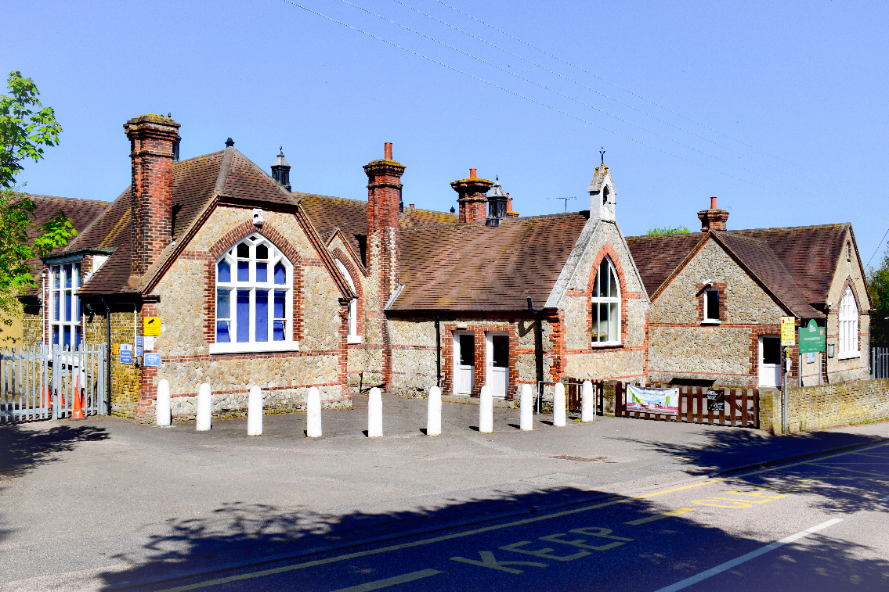
Welcome to
Higham Primary School

Slide 2
Welcome
Thank-you for expressing an interest in Higham Primary School.
Choosing a primary school for your child is one of the most important decisions you will ever make. Education is fundamental to everyone's lives and getting the right start in life is vital. We believe that here at Higham Primary School, we have the right balance. We are very proud of our child centred approach and celebrate the success and achievements of our children. Our children are encouraged to achieve the highest academic standards possible, in a nurturing, inclusive and supportive learning environment that values every individual and develops children to have high self-esteem, morals, self-confidence and motivation to succeed.
Our children are happy, they are eager to learn and behave well.

Slide 3
Our School Motto
Grow | We will grow in character, confidence and knowledge as we progress through the school.
Learn | We embrace new challenges and are eager to learn to the best of our ability.
Achieve | We use and build upon our skills to achieve our academic and personal goals.
Believe | We believe in ourselves and encourage and support each other.

Slide 4
HIGHAM VALUES
RESPECT
Teamwork
Creativity
Kindness
Perseverance
Responsibility

Slide 5
Partnership with Parents
We highly value the parent partnership that enables the children to do as well they can as we work together.
Higham Primary PTA
Governing Body
Home Learning
Parent Workshops and Meetings

Slide 6
Applications for Starting School in September 2026
You can apply for September 2026 places from Friday 7th November 2025 until Thursday 15th January 2026.
Children should start primary school if born: Between 1st September 2021 and 31st August 2022.
The schools admissions criteria is in line with the Local Authority as follows;
  Children in Care
  Siblings
  Evidence based Severe Health / Medical Needs
  Distance
Admissions can tell you your address distance if you contact them.
The LA look at first preferences, allocate these places based on the admission criteria i.e. distance, siblings and then if they can’t give a first preference move onto second, third etc.

Slide 7
Key Dates for Application Process
Closing date for applications to Kent: 15th January 2026
National Offer day; 16th April 2026
Welcome letters from the school; from 20th April 2026
Places accepted/rejected and waiting lists; by 30th April 2026
Lodging of Appeals until 18th May 2026
Vacant places reallocated from 21st May 2026

Slide 8
Familiarisation
In June 2026, there will be a new parent meeting which will provide you with an overview of the Early Years Foundation Stage, equip you with key information and give you the opportunity to meet the Foundation Stage team.
In July 2026, the children will be invited to visit Hedgehog Class for two sessions where they will be able to meet their teacher, their classmates and become familiar with the school environment. They will sample some of the activities that we set up in our daily provision.
In July, the Foundation Stage team will contact your child’s nursery or preschool for additional information about your child to ensure a smooth transition.
In September 2026 we will carry out 1:1 meetings in school on the first two days of term.

Slide 9
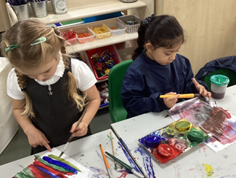
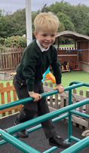
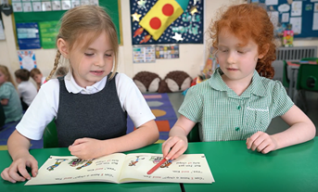
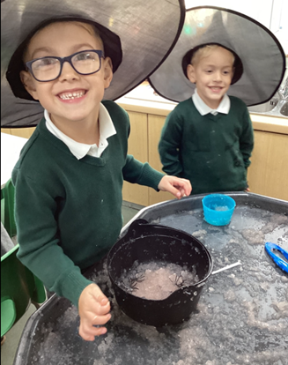
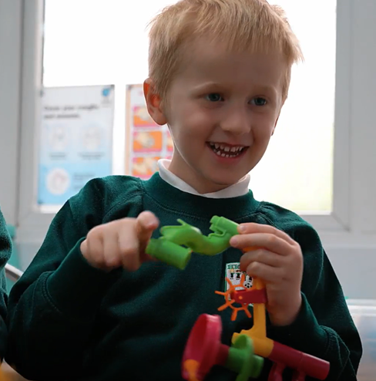
Early Years Foundation Stage
We value each and every one of our children as an individual right from the start of their journey at Higham Primary School and our caring staff ensure they have a smooth transition from pre-school.
In EYFS we follow the Early Years Foundation Stage curriculum. Our children are nurtured in a secure environment, whilst being allowed to explore, enquire and develop their learning both inside and outside the classroom

Slide 10
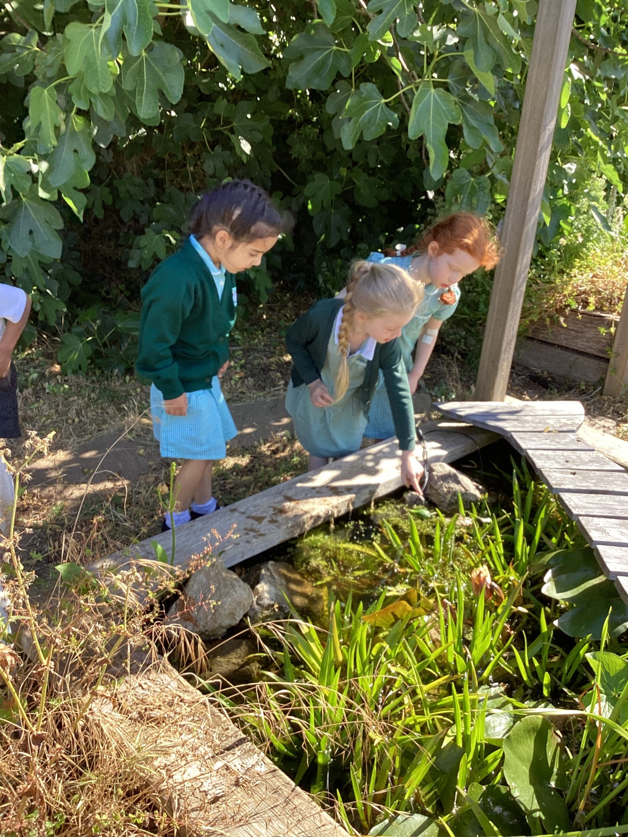
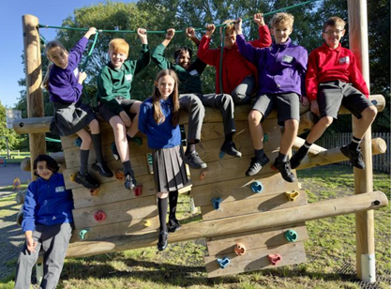
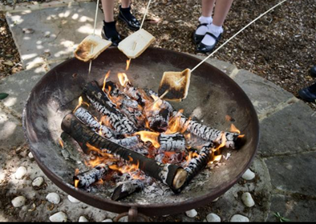
Outdoor Learning
At Higham Primary School we are fortunate to have many fantastic outdoor features. We have extensive grounds with a dedicated outdoors science area, containing a pond and a wide variety of natural habitats. There are two football pitches and a smaller field with a trim trail. Across the two playgrounds there is also basketball hoops, a wide variety of playground game markings, large play apparatus for Key Stage 2, a climbing wall and a tyre park.

Slide 11
Breakfast and After-School Club
At Higham Primary we operate a successful breakfast and after school club term time only.
Our breakfast club is open from 8.00 am until 8.40 am and our After School Club is open from 3.20 pm until 5.45 pm.
We provide a high quality service which meets the needs of both parents/carers and children. For parents/carers, this means knowing that your child is safe and happy in a club that is reliable and offers a consistent service. Higham Primary School will ensure that appropriate standards of behaviour, discipline and hygiene are maintained.

Slide 12
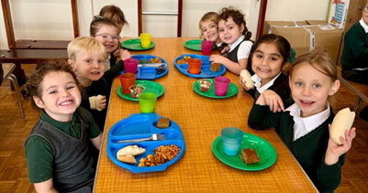
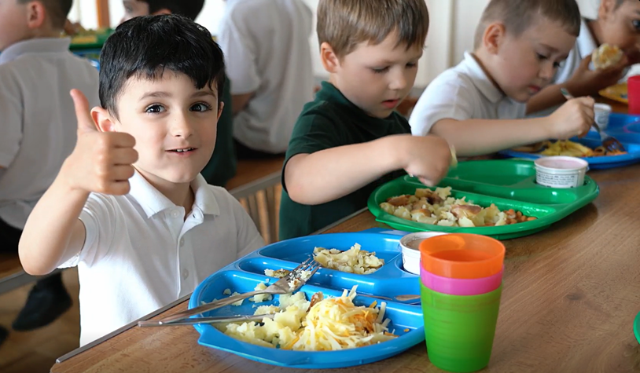
School Meals
At Higham Primary School we help children develop healthy eating habits and ensure that they get the energy and nutrition they need across the whole school day. Our on-site cook, cooks food that looks good and tastes delicious. Our menus are changed regularly in consultation with the children. Please look at the school website for our latest menu.
All children in reception, year 1 and year 2 automatically get free school meals.

Slide 13
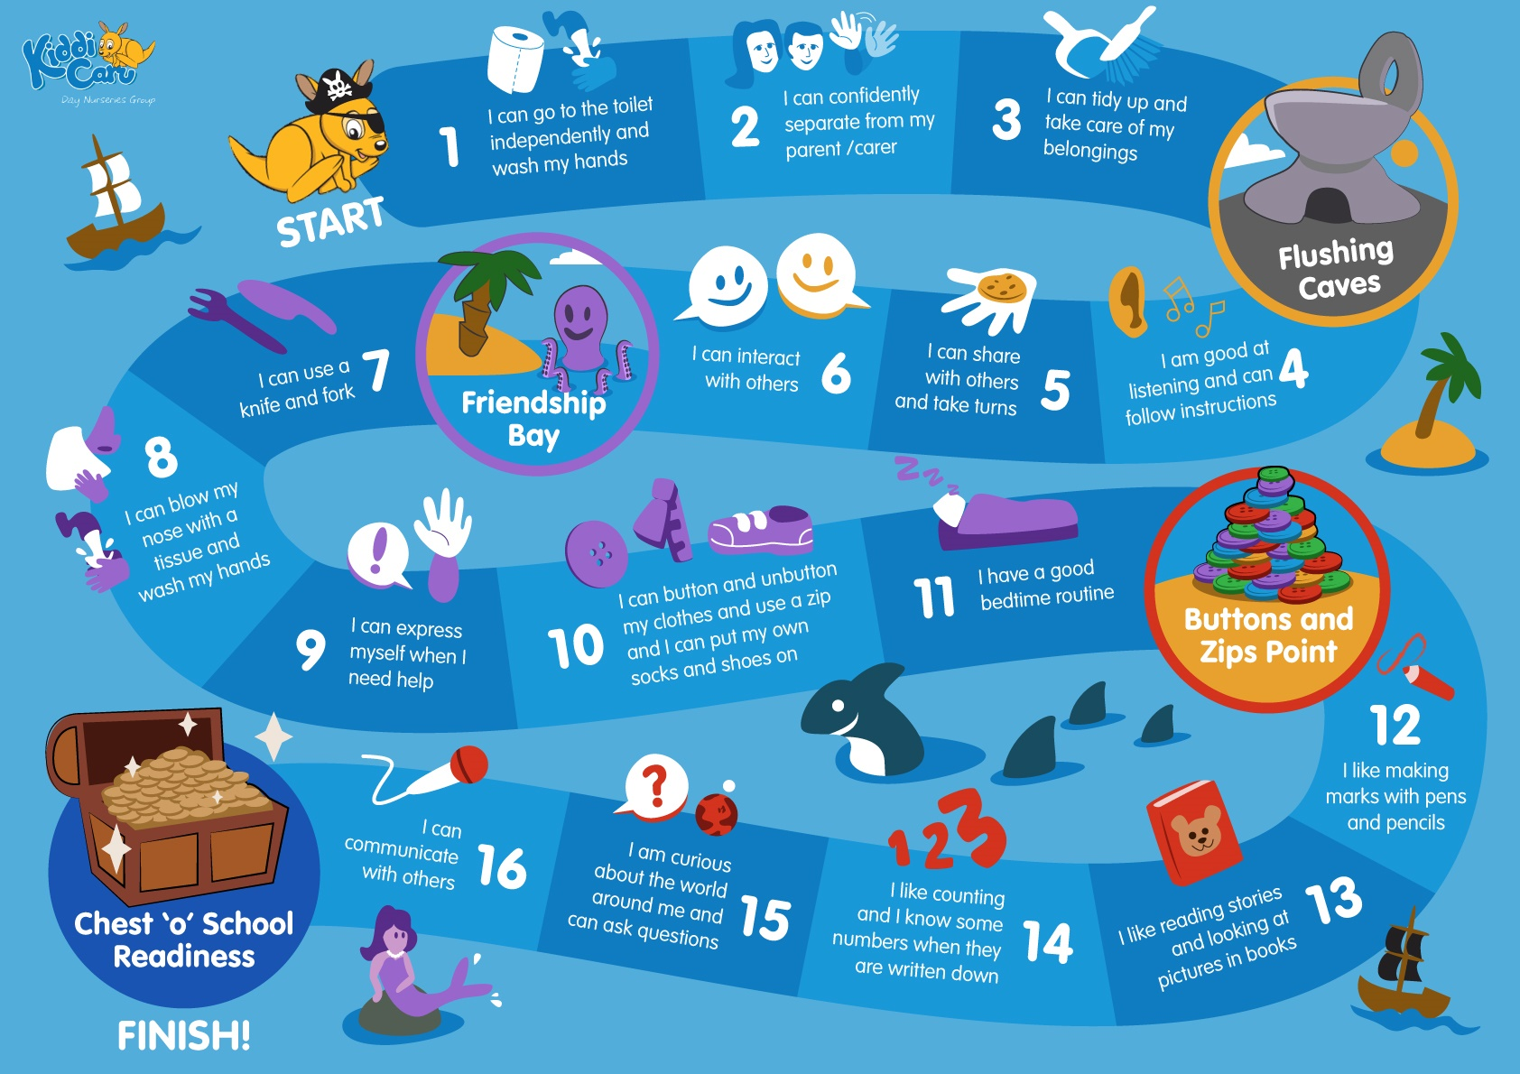
Getting your child ready for school

Slide 14
Any questions?
Our House Captains and Vice Captains, will now take you on a tour of the school. Please feel free to ask them any questions during your tour.
Don’t forget to check out our website and Facebook page!
Please ring the School Office if you have any other questions.

