Slide 1
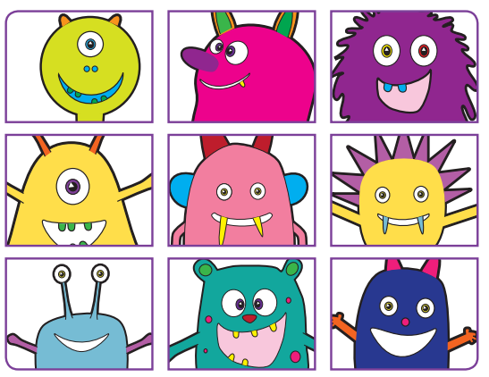
Phonic Screening Check
Monday 10th June 2024 - Friday 14th June 2024

Slide 2
Reading changes everything
Teach a child to read and keep that child reading and we will change everything.
And I mean everything.
Jeanette Winterson
Notes:
Read quote.
Today I want to help you understand more about the Phonics Screening Check – a word reading test that all Year 1s undertake in June.
Accurate word-reading at six is a good predictor of future reading success.
In December 2018, research found that nearly 90% of children who passed the phonics check taken in Year 1 reached or exceeded the expected standard in reading in Year 6.

Slide 3
What is Phonics?
Phonics is the method of teaching reading through the identification of sounds and graphemes.
The National Curriculum ensures that all children are taught Phonics systematically.
This gives your children the tools to read any word.
Children begin to learn phonics in Reception using Read Write Inc.
Once children begin learning sounds, they use this knowledge to read and spell words.

Slide 4
What is the Phonics Screening Check?
Children in Year 1 throughout the country will all be taking part in a phonics screening check during the same week in June. Children in Year 2 will also take the check if they did not meet the required standard.
The phonics screening check is designed to confirm whether individual children have learnt sufficient phonic decoding and blending skills to an appropriate standard.

Slide 5
Phonic Screening Check
40 words and non-words read one-on-one with a familiar adult.
Non-words / pseudo words / monster / alien words. Your child will need to read these made-up words with the correct sounds to show that they understand the phonics rules behind them. E.g. ind, yog, thrant, braft. They have had lots of practise at this!
The check is divided into two sections:
Section 1 - with simple word structures with three or four sounds e.g. shed, chart, wink, soil
Section 2 - more complex word structures e.g. glued, cloaks, strike, midnight, playground, comic, fighters, tantrum.
The children are familiar with how the test is administered and have completed several practices.

Slide 6
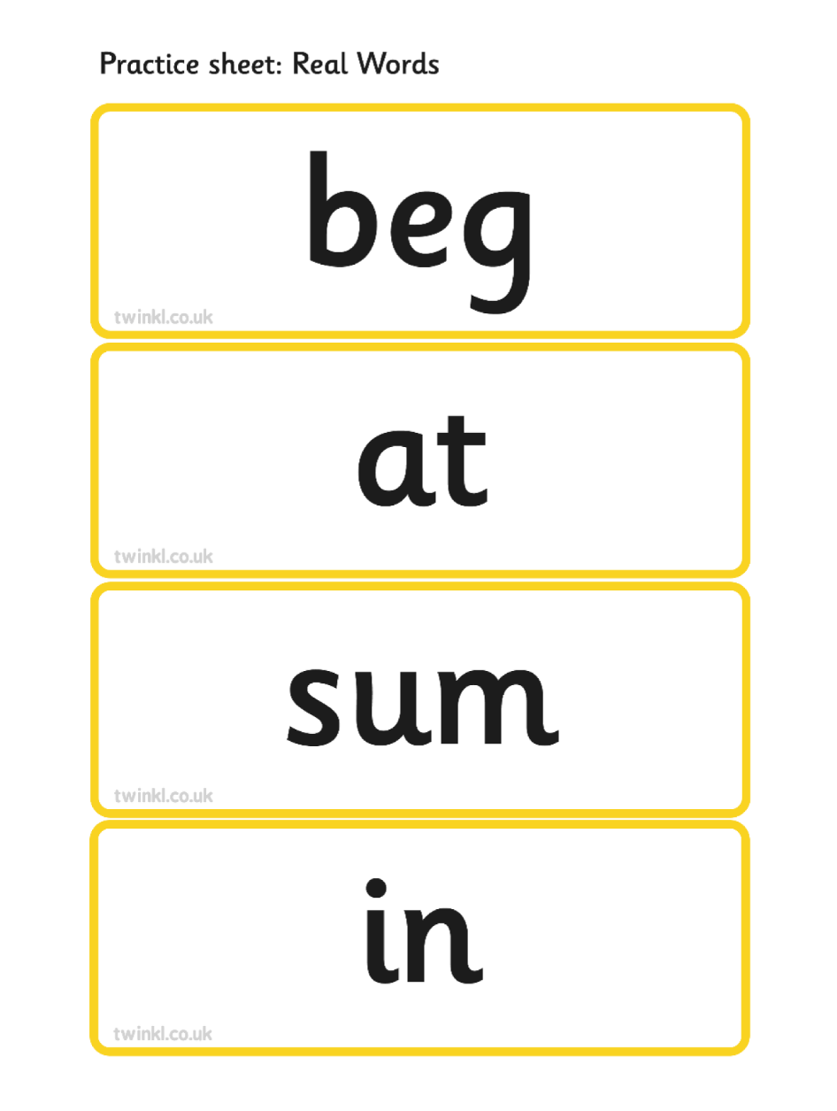
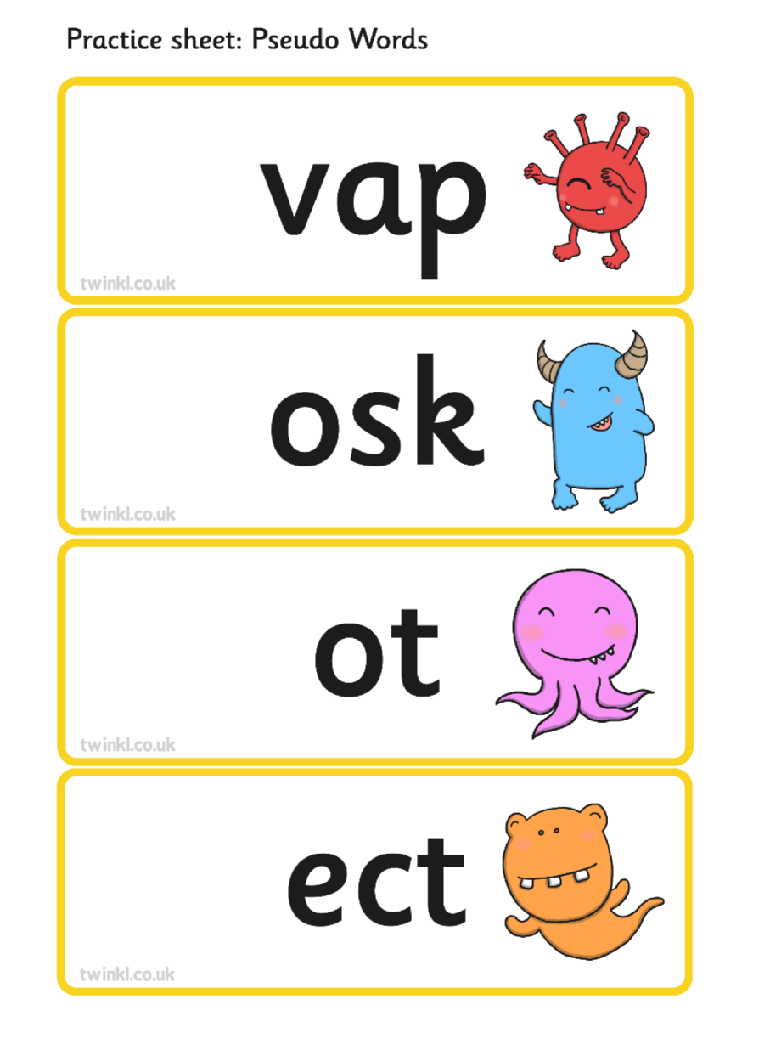
Example of the Phonics Screening Check

Slide 7
What does my child’s score mean?
Your child will be scored against a national standard and the result of whether or not your child has met the required standard will be reported to you in their end of year school report in July 2024
In previous years the "pass threshold" was 32, which means children had to read at least 32 words out of 40 correctly. However the pass mark is subject to change each year.
If your child’s score falls below the standard, they will re-take the Phonics screening check in Year 2.

Slide 8
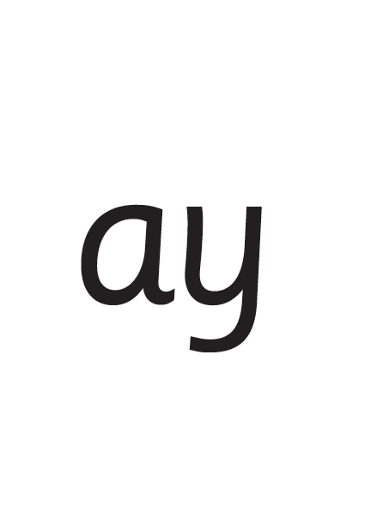
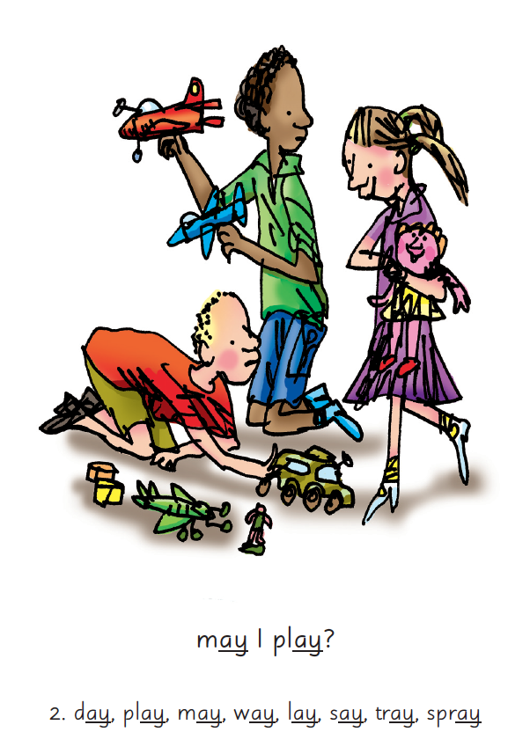

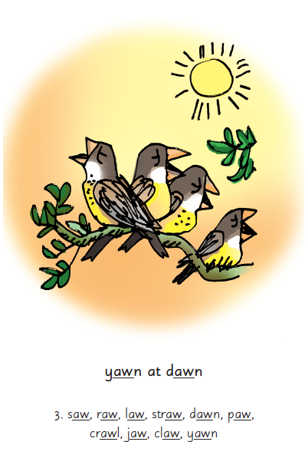
Picture Phrases
How we teach Phonics
Notes:
We teach children sounds using a picture phrases to help them remember.
For example, ay, may I play? aw, yawn at dawn.
Many sounds have two or more letters making one sound. We call these ‘Special Friends’.

Slide 9
They need to know all these sounds

Slide 10

‘Special Friends’, ‘Fred Talk’, Read the word
Reading Routine
Notes:
We teach children to read both real and nonsense words using the routine ‘Special Friends’, ‘Fred Talk’, read the word’.
Children spot the ‘Special Friends’ (two letters that make one sound), Fred talk the word, and then read the word as a whole.
For example, ‘sh’, sh-i-p, ship.

Slide 11
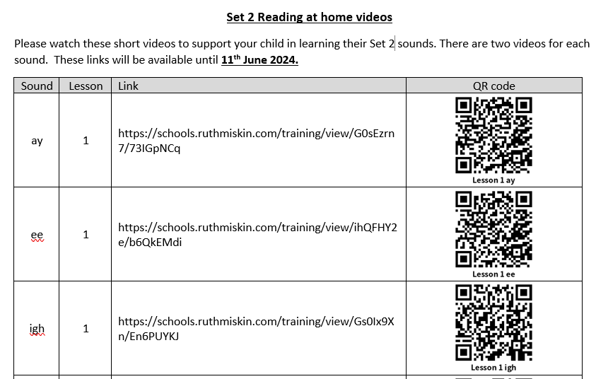
Special Friends, Fred Talk, Read the word

Slide 12
How to help at home
Listen to your child read at least 4 times a week. Evidence suggests that children who read for enjoyment every day not only perform better in reading tests than those who don’t, but also develop a broader vocabulary, increased general knowledge and a better understanding of other cultures.
Use the Reading Routine ‘Special Friends’, ‘Fred Talk’, Read the word’ to read words
Practise reading sounds speedily - ‘review, review, review’
Practice making words using sounds
Watch the short videos sent home via qr codes
Use resources from the Homework Phonics Book – this will be emailed to you
Play games online

Slide 13
Online resources available
Ruth Miskin Parents’ Page:
https://www.ruthmiskin.com/parents/
Ruth Miskin Facebook:
https://www.facebook.com/miskin.education
Free e-books for home reading:
http://www.oxfordowl.co.uk/Reading/

Slide 14
The more that you read, the more things you will know. The more that you learn, the more places you’ll go!
Dr. Seuss
Notes:
In the words of Dr Seuss…read quote.
Good readers do well in school – and in life.
By listening to your child read, you are making sure they have the opportunity to practise and become a good reader quickly.
Remember that all parents have the power to change outcomes for their children.

Slide 15
Any Questions

