Slide 1


Welcome to Robins Class
Your teacher’s are Miss Lopes and Mrs Cousins (Thursday)
Your teaching assistants are Miss Harmon and Mrs Defrates

Slide 2
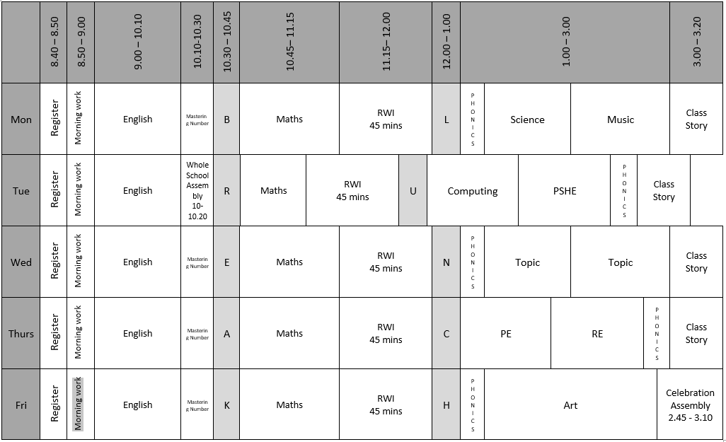
Timetable of the Day

Slide 3
English
In English this term we will explore stories based on toys. We will read ‘Stanley’s Stick’ and ‘That rabbit belongs to Emily Brown’.
We will be practising writing sentences using capital letters and full stops.
Children will also take part in daily Read Write Inc lessons to support their phonics and reading.

Slide 4

Phonics – Read Write Inc
RWI will continued to be used to teach phonics.
Please make sure your child watches the short videos that are sent home to further support their phonics. QR codes are provided so hopefully they are easy to access. Any problems please let me know!

Slide 5
Phonics screening
Children begin to learn phonics in Reception. Once children begin learning sounds, they use this knowledge to read and spell words.
On the week beginning the 10th June 2025 your child will be tested on their phonic knowledge.
Children in Year 1 throughout the country will all be taking part in a phonics screening check during the same week in June. Children in Year 2 will also take the check if they did not meet the required standard when in Year 1.
The phonics screening check is designed to confirm whether individual children have learnt sufficient phonic decoding and blending skills to an appropriate standard.

Slide 6
Reading at Home Key Stage 1
Children will take home a decodable book that is closely linked to their phonics knowledge. These books will be changed on Monday and Thursday. This book will be recorded in their reading record book.
Children will also take home a paper copy of the RWI book they have read in class (to be kept in a plastic wallet). This is to develop fluency at home as they would already be familiar with the text.
Children will also take home a sharing / reading for pleasure book. This book is for children to share with their parents to help develop a love of reading.
We expect all children to read for between 10 and 15 minutes every evening each school day, and once at the weekend.

Slide 7
Impact of Reading
Amount of reading | 20 mins | 5 mins | 1 min
Number of minutes per year | 3600 | 900 | 180
Number of words per year | 1.8 Million | 282,000 | 8000
Hours read by the end of primary school | 851 | 212 | 42
Performance on tests | 90% | 50% | 10%

Slide 8

Reading from an early age and securing phonics
Reading from an early age is important as research shows that if children are not secure and fluent readers by Year 2, it is very difficult to then develop a love of reading going forward.
In order to get children fluent in reading, their phonic knowledge must be embedded within EYFS and KS1.
Read to children from day zero!

Slide 9

Maths
This term in Maths we are learning about place value working with numbers to 10. Here are some of the things we will be doing,
Sorting groups of objects.
Counting groups of objects.
counting on from any number.
Finding 1 more and 1 less than an amount.
Comparing groups of objects.
In year 1 we would like the children to use the computer programme Numbots at home for at least 10 minutes per week to help improve their Mathematical skills.

Slide 10
How to help your child with Maths
Practise writing the numbers 1 2 3 4 5 6 7 8 9 10.
Matching amounts of objects to the number.
Counting forwards and backwards.
Saying a number and getting your child to find 1 more or 1 less.
Matching the number digit to the word for example 1 with one.
Encourage them to use Numbots for 10 minutes every week.

Slide 11
Topics
Our topic this term is ‘A trip down memory lane’.
We will be finding out about what childhood was like in the past. In particular we will be looking at toys from the past.
In science we are learning about everyday materials. We will become familiar with the names and properties of everyday materials.

Slide 12

PE
Our PE day is Tuesday
Please make sure you are wearing the correct PE kit:
T-shirt in house colour (Twist, Copperfield, Peggotty or Pip)
Fleece in house colour or black hoodie
PE shorts in green/black
Jog bottoms or legging in black only
No logos on any items of clothing- please wear plain black only.
(PE bag not required)

Slide 13
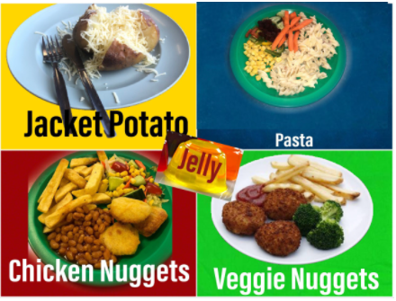
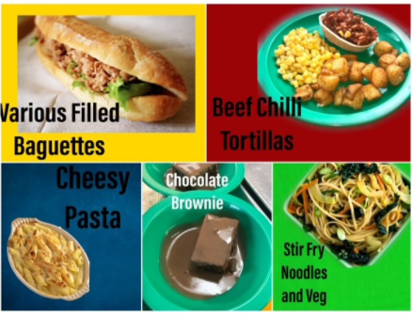
Lunch
Don’t forget to try our yummy school dinners
Menus are on the school website
Please wherever possible, order you child’s meal in advance on Bromcom as this makes morning registration much quicker

Slide 14
Every Day and Every Week
Daily
Healthy snack – new guidance on the next slide
Water bottle
Named uniform
Reading Book
Contact book – for queries and issues
Weekly
Reading book changing – your child needs to bring in reading book and record so that it can be changed on a Monday and on a Thursday.

Slide 15
Healthy Snacks
Fresh fruit or vegetables – prepared and ready to eat and in a named snack pot.
Plain breadsticks (nut / sesame seed free) – out of their wrapper and in a named snack pot.
Pitta bread or other bread – out of their wrapper and in a named snack pot.
As stated above, wrappers will not be allowed and snacks need to be in a named snack pot (ideally please name the pot and its lid so we can pair the two back up if they become separated).

Slide 16
Volunteers
We always appreciate help from parents/grandparents/aunts/uncles in hearing children read.
If you or anyone else in your family can come in to help us please let us know.

Slide 17
Thank-you for coming
Any questions?

