Slide 1


Welcome to Rabbits class
Your teacher’s are Mrs Barkel (Monday, Tuesday and Wednesday) and Mrs Levy (Thursday and Friday)
Your teaching assistant is Mrs Defrates.
Miss Harmon and Miss Reece also support in class.

Slide 2
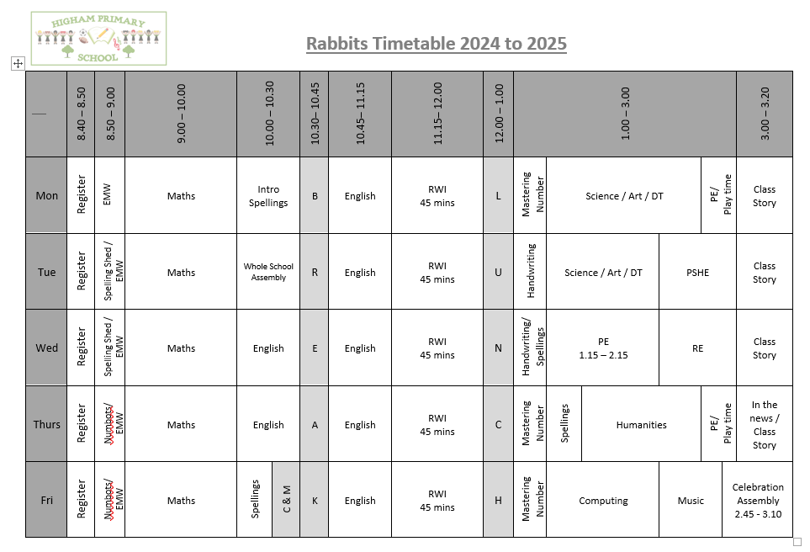
Timetable

Slide 3

English
In Term 1 we will focus on:
Developing a secure understanding of key grammatical concepts. This will be covered through the use of Grammarsaurus Place Value of Punctuation and Grammar (PVPG).
Learning to join our handwriting and making sure we are forming our letters correctly.

Slide 4

Phonics – Read Write Inc
RWI will be continue to be used to teach phonics.
Please make sure your child watches the short videos that are sent home to further support their phonics. QR codes are provided so hopefully they are easy to access. Any problems please let me know!

Slide 5
Reading at Home Key Stage 1
Children will take home a decodable book that is closely linked to their phonics knowledge. These books will be changed on Mondays and Thursdays. This book will be recorded in their reading record book.
Children will also take home a paper copy of the RWI book they have read in class (to be kept in a plastic wallet). This is to develop fluency at home as they would already be familiar with the text.
Children will also take home a sharing / reading for pleasure book. This book is for children to share with their parents to help develop a love of reading.
We expect all children to read for between 10 and 15 minutes every evening each school day, and once at the weekend.

Slide 6
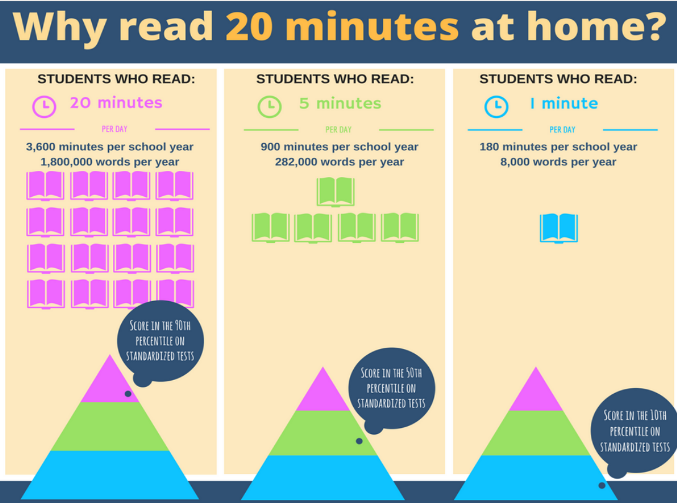

Slide 7

Reading from an early age and securing phonics
Reading from an early age is important as research shows that if children are not secure and fluent readers by Year 2, it is very difficult to then develop a love of reading going forward.
In order to get children fluent in reading, their phonic knowledge must be embedded within EYFS and KS1.
Read to children from day zero!

Slide 8

English - Spellings
This year, we will be using Spelling Shed to teach and practice spellings. They will have a 30 minute lesson every Tuesday which will focus on a spelling rule or pattern, followed by spelling activities throughout the week linked to the spelling rule or pattern being studied. ​
There will be a weekly spelling test every Monday. A list of the spelling rules/patterns will be sent home weekly with the children​
Pupils will all have a Spelling Shed account and will have access to the online games which will support them in strengthening their recall.
A Parent Guide is available here: https://play.edshed.com/en-gb/login

Slide 9
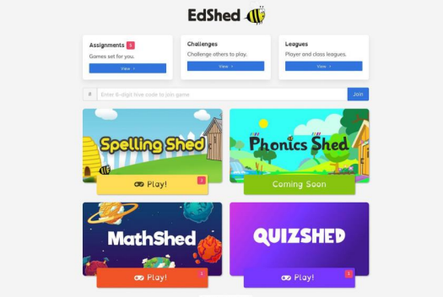
Pupils can log in using the username and password and it will take you to this screen. You do not need to buy the app. You can use spelling shed FREE on a web browser.
The pink notification boxes indicate how many assignments have been set by the teacher and on which game.
If you click on the assignments box at the top of the menu, you can see all of the assignments together.

Slide 10
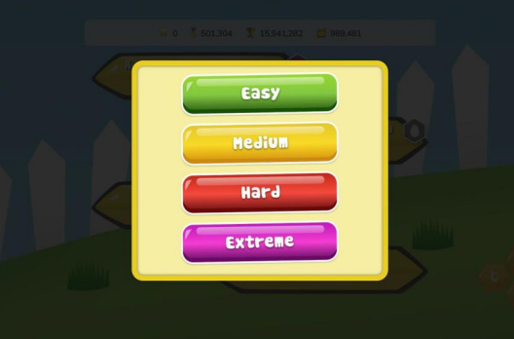
Play
When you click ‘Play’, four difficulty options will appear.
Easy - You will be shown the word as well as hearing it and you will only see the letters you need to spell it.
Medium - You can listen to the word and you will only have the letters you need.
Hard - You can listen to the word but you will have a few extra letters added
Extreme - You will hear the word and you have a full keyboard of letters
These levels of difficulty apply to solo and hive games. Games completed on easier levels will give the player a lower score and lower ranking. The teacher will be able to see which levels have been chosen for each game.

Slide 11

Maths
The children continue to have access to Numbots
We expect them to use the programme for at least 15 minutes each week.
The class newsletter has a QR code for a parent guide to Numbots.
Their username and password is in the front of their reading record book.

Slide 12
What are we learning?
Topic – Exploring the World – The children will learn about where the seven continents of the world are and how their proximity to the Equator or the Poles affects their climate. They will also name and locate the World’s five oceans. Children will be introduced to hot and cold areas of the World and navigate these on a world map. They will investigate different countries linked with their own experience and explore the climate and land features. In depth studies will be made of Antarctica as a cold location and Kenya as a hot location.
The children will discover what it is like to be an explorer. They will find out who Ernest Shackleton was and why his expedition to the South Pole was so challenging. They will learn about a recent explorer, Felicity Aston, comparing her expedition to that of Shackleton over 100 years ago.
Science – Animals including humans. We will notice that animals, including humans, have offspring which grow into adults. We will find out about and describe the basic needs of animals, including humans, for survival (water, food and air). We will describe the importance for humans to exercise, eat the right amounts of different types of food, and hygiene.
Further information about what we are learning can be found on the school website. Please see the class newsletter for links.

Slide 13

PE
Our PE day is Wednesday.
Please make sure you are wearing the correct PE kit:
T-shirt in house colour (Twist, Copperfield, Peggotty or Pip)
Fleece in house colour or black hoodie
PE shorts in green/black
Jog bottoms or legging in black only
No logos on any items of clothing- please wear plain black only.
(PE bag not required)

Slide 14
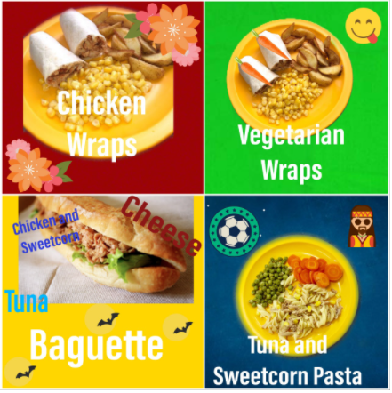
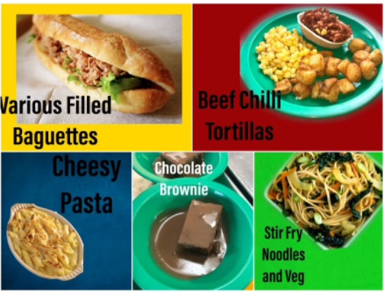
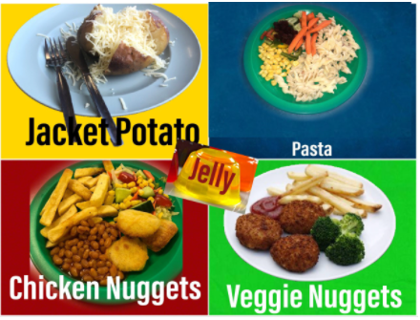
Lunch
Please order your child’s lunch via Bromcom.
Menus are on the school website

Slide 15

External tests
The end of key stage 1 (KS1) assessments are no longer statutory from the academic year 2023 to 2024 onwards.

Slide 16
How to support your child at home
Helping with homework
Encouraging them to use Numbots and Spelling Shed weekly.
Hearing them read
Lots of useful information on the School Website

Slide 17
What they need to bring each day
Reading book and Reading Record Book
Named Water bottle
All clothing named
Snack in a named pot
Fresh fruit – prepared and ready to eat
Fresh vegetables – prepared and ready to eat
Plain breadsticks (nut / sesame seed free) – out of their wrapper and in a named snack pot.
Pitta bread or other bread – out of their wrapper and in a named snack pot.

Slide 18
Volunteers
We really need volunteers to hear children read, please let us know if you are able to help, even if it is an hour a week. Please email the office if you are able to help.

Slide 19
Thank-you for coming
Any questions?
Remember any problems please come and speak to us, so we can sort things out as quickly as possible. We are available at the end of the day (except Wednesday) or email the school office.

