Slide 1

PGL Parent’s Meeting
March 2025

Slide 2
Contents of Today’s Meeting
Where we’re going, why we go and what we do
Adults taking us
Packing
Spending Money
Departure Day
Coming Home
Essential Paperwork and Keeping Up to Date

Slide 3
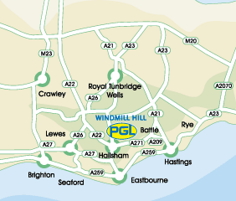
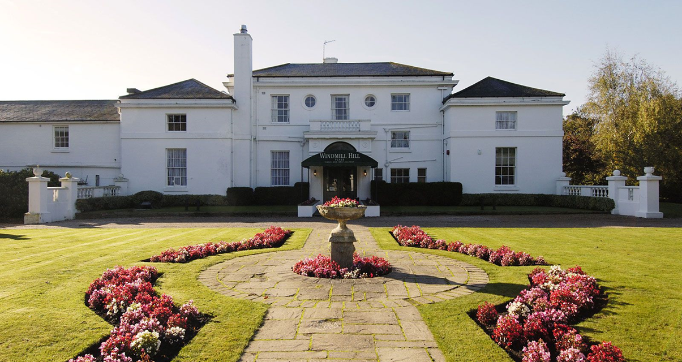
PGL Windmill Hill – East Sussex
PGL is a self contained activity centre with 24 Hr Security.
Everything we need, accommodation, activities and food, are all on-site.
Located close to the coast on the beautiful Sussex Downs… #views

Slide 4
Trip Objectives…
To experience new activities
To challenge ourselves by setting and achieving goals
To become more independent
To support one another and become a good team player

Slide 5
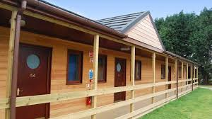
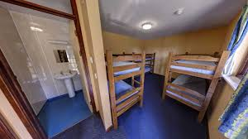

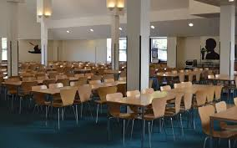
We will be allocated accommodation upon arrival.
We will be staying in comfortable wooden lodges, consisting of bunk beds and with an en-suite toilet and shower.
Adult rooms are at the end of our allocated block.
All bedding is provided.
We will have our meals in the Dining Room alongside other schools and groups.
There is plenty of options available including a well stocked salad bar at lunch and dinner.
The catering staff work very hard in ensuring there is something for everyone to eat and cater to even the “fussiest” of eaters.

Slide 6
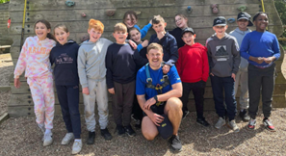
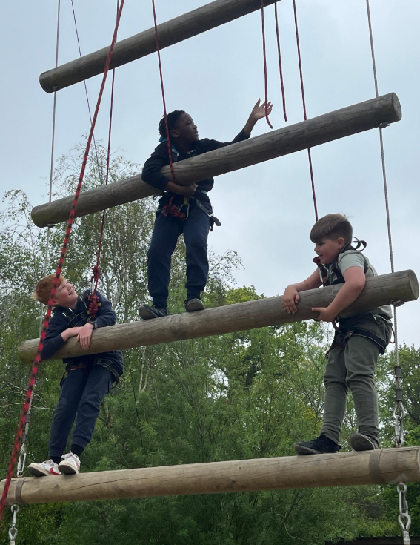
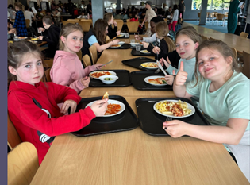
Upon arrival, we will be split into 2/3 activity groups for the day sessions.
Pupils from the same bedroom may not be in the same activity group.
We are altogether during free time, meals and evening activity sessions.

Slide 7
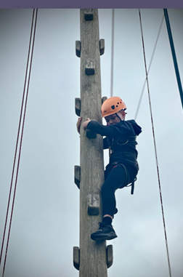
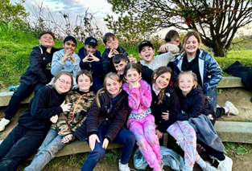
A Sample Day at PGL
7.30 –Wake up call from school staff
8.00-8.45 – Breakfast
9.00- 12.00 – Two activities in groups
12.00-13.30- Lunch and free-time with organised games
13.30 – 16.30 – Two activities in groups
17.00- 19.00- Dinner and free-time
19.00-20.30 – Organised evening activity
21.00- Lights out!

Slide 8
Behaviour and Keeping Safe
Pupils will not be allowed to take part in any activity that either PGL or school staff consider to be a danger as a direct result of misbehaviour and/or lack of listening to/following safety instructions

Slide 9
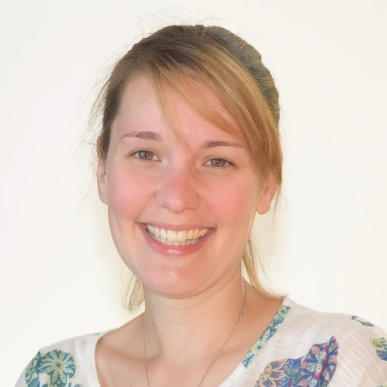
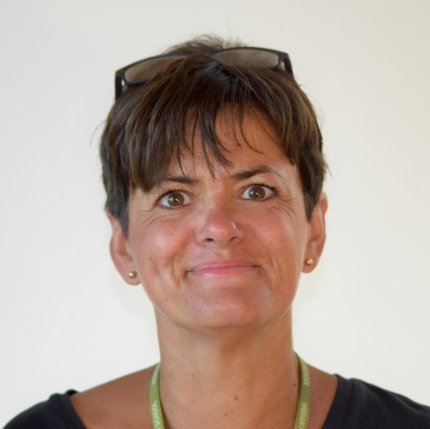
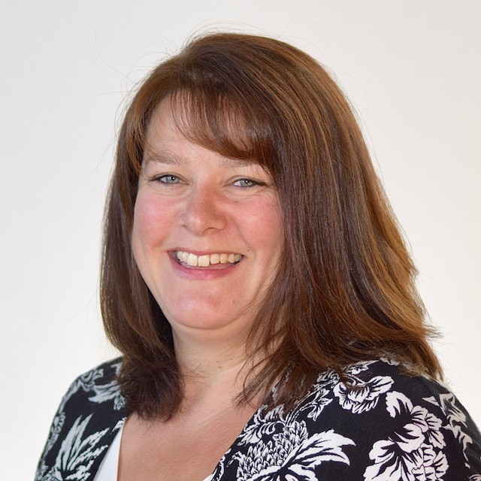
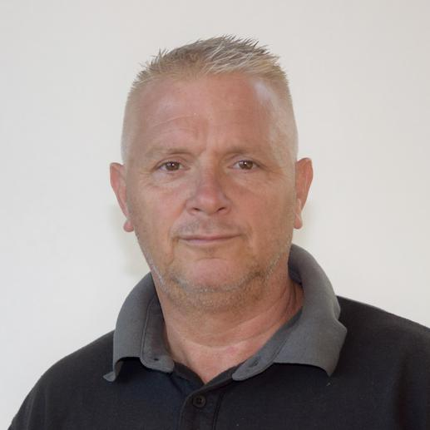
The Adults Attending
Drum roll please….
Mrs Cousins
Mrs Munn
Mrs Smith
Mr Walton

Slide 10
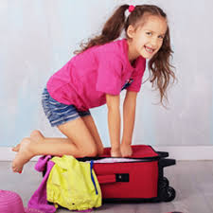
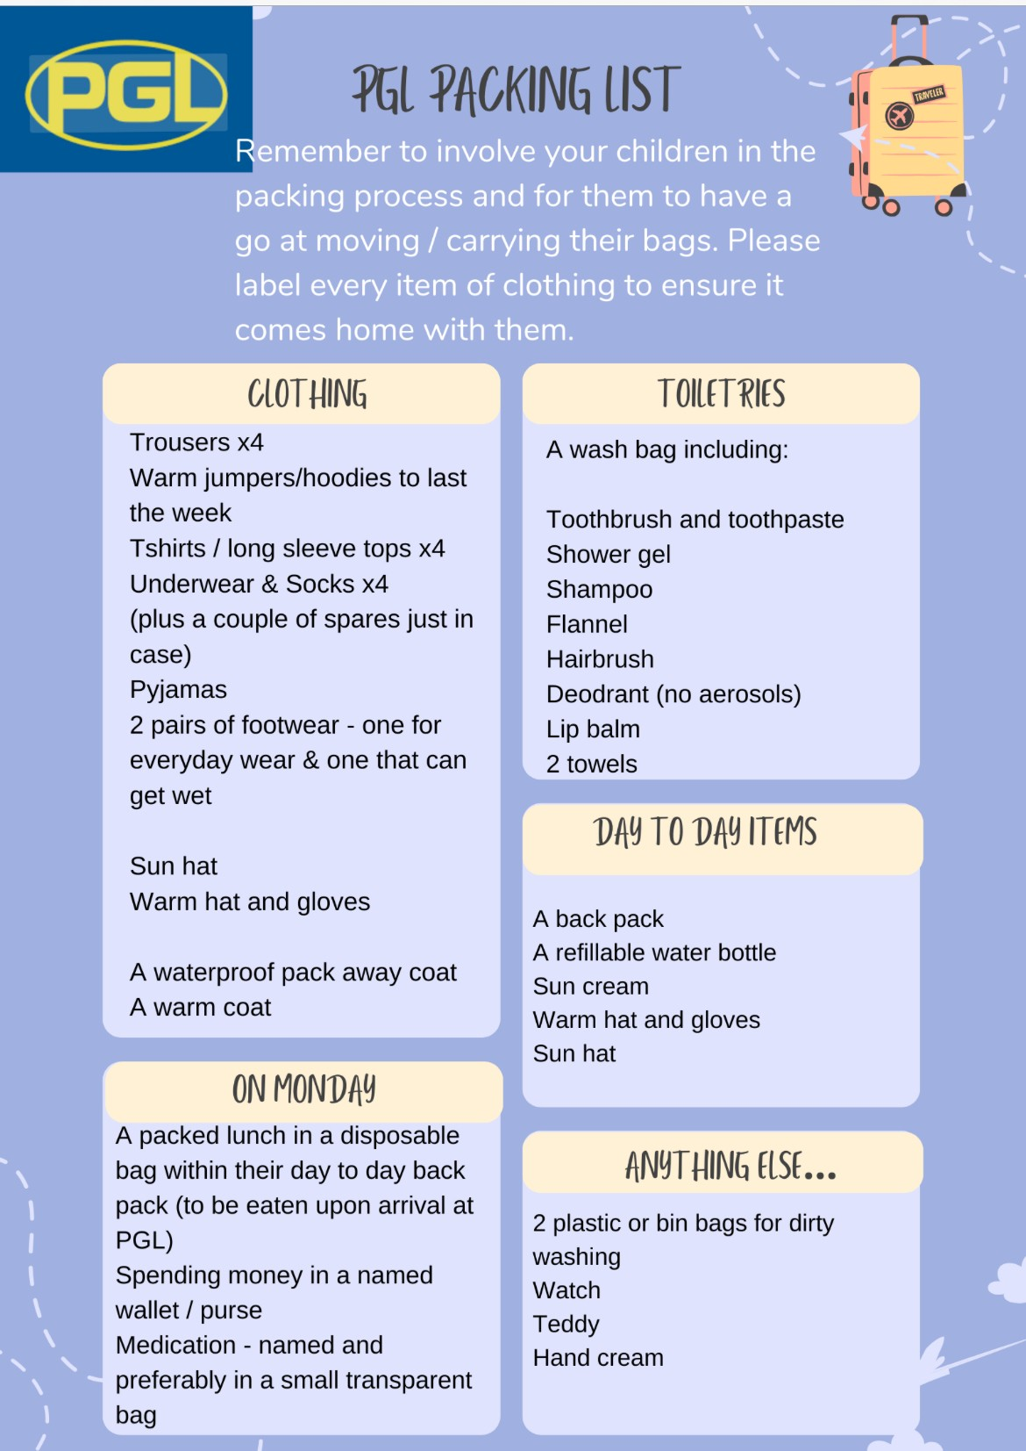
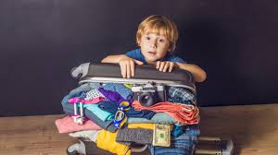

Slide 11
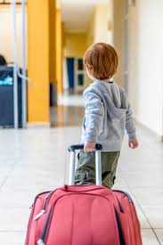
Packing Tips
Name everything!
Involve your child in packing their bags so they know what they have – you could make a list of what is inside that they can then use as a checklist when they repack.
Name everything!!
Ensure they can carry / move their own bag. It can be quite a walk from the coach to our rooms, and can include hills and steps.
One more time…
NAME EVERYTHING!

Slide 12

What not to pack in your child’s bag…
Medication including calpol
Sweets and food
Electrical items
Games consoles/iPads or tablets
Mobile phones
Bedding (pillows or sleeping bags)

Slide 13
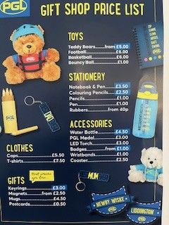
Spending Money
Children can take a max. £15 spending money.
We recommend that this is in change
Must be in a named purse/wallet or envelope
Hand all money in at check-in for staff to look after.
Staff will hand purses and wallets over as we visit the shop and collect them in afterwards.
We hope to have one visit to the onsite shop to buy souvenirs and gifts.

Slide 14

Departure Day
Please arrive at school with your luggage, day bag (small rucksack), any medication and spending money between 9:15 and 9:30.
Remember to hand in any medication and spending money.
Remember to bring your own packed lunch and water bottle to eat upon arrival at PGL.
We will be leaving school at 10am (feel free to wave us off)!
There are no scheduled stops. If, due to traffic, a stop becomes necessary, staff will carry out a risk-assessment prior to pupils being allowed off of the coach and will be accompanied by staff at all times.

Slide 15

Coming Home
On our last morning the children we will have breakfast.
Then, the children finish packing their own bags (remember to label everything), strip their beds and empty rubbish bins.
We will have an activity / presentation of certificates.
Collect our PGL Packed Lunches.
Board the coach to travel back to school.
Children can be collected from 1pm. Please do inform the office asap if you will be late collecting to avoid upset children.

Slide 16
The Paperwork
Every child will need a completed medical form as this provides us with:
Parental consent for receiving emergency medical treatment
Parents and doctors contact details
Information about medical needs and medication required
Information on your child’s water confidence required by PGL

Slide 17
Medication
All medication must be labelled with your child’s name, in date and handed in on the day of departure.
Any medical problems that we need to be aware of that arise last minute need to be in writing.
Please make sure travel sickness medication is taken and handed in.
There should be no medication in your child’s bag

Slide 18


Keeping in Touch
There will be no phone contact with the children whilst away.
Any phones found will result in parent’s coming to collect their child from PGL.
We will be using Class Dojo to keep in touch.
We will blog what we’re getting up to throughout the day with information and photos.
A Class Dojo agreement must be signed for you to access this.

Slide 19

We look forward to taking you all on PGL this year!

