Slide 1



Higham Primary School
Secondary Admissions
Information Evening
18.6.25

Slide 2
Choosing a secondary school….
All secondary schools have an opening evening in Term 1.
Some need to be pre-booked so check with the school you would like to visit. Some start as early as 5pm so be prepared and check in advance on their website.
It is good to visit when in Year 5 and when in Year 6.
If you are not sure contact the school.
Look at as many secondary schools as possible so as to make an informed choice.
If your child is SEN always ask to speak to the SENCO to get a feel for what they can offer.
All secondary schools have an open morning in term 1 – These need to be booked in advance directly with the school.
This gives you an idea of the school in action. Alert us if you intend to visit a school and the absence will be authorised.

Slide 3
Key Action | Scheme date
Registration for testing opens | Monday 2 June 2025
Closing date for registration | Tuesday 1 July 2025 (midnight)
Application for Secondary Transfer opens | Monday 1 September 2025
Test date for pupils in Kent Primary schools | Thursday 11 September 2025
Test date for pupils not in Kent Primary schools from | Weekend of 13/14 Sept 2025
Assessment decision sent to parents | Thursday 16 October 2025
National closing date for application forms | Friday 31 October 2025
National Offer Day: e-mails sent after 4pm | Monday 2 March 2026
Schools send out welcome letters no earlier than | Wednesday 4 March 2026
Deadline for late applications and waiting list requests to be included in the Kent County Council reallocation stage. Also the date by which places should be accepted or declined to schools. | Approximate: Monday 16 March 2026
Deadline for lodging appeals | Approximate: Monday 30 March 2026
Kent County Council to reallocate places that have become available from the schools’ waiting lists. After this point, schools will take back ownership of their waiting lists. | Approximate: Friday 24 April 2026
Key Dates….
Kent

Slide 4
Key dates from secondary school admissions 2026
Date | Event
9am on Monday 19 May 2025 | Registration for the Medway Test (11+) opens.
5pm on Friday 13 June 2025 | Registration for the Medway Test closes.
Monday 23 June 2025 | Closing date for special arrangements requests from schools.
Monday 1 September 2025 | Secondary school applications open.
Tuesday 16 and Wednesday 17 September 2025 | Medway Test dates for children who attend Medway primary and junior schools.
Saturday 20 or Sunday 21 September 2025 | Medway Test date for children from non-Medway schools. One day will be allocated to each child who attends a non-Medway primary or junior school.
Wednesday 15 October 2025 | Results of the Medway Test.
Friday 31 October 2025 | Secondary school applications close.
Monday 2 March 2026 | Offers sent to parents and carers.
Friday 27 March 2026 | Deadline for accepting/refusing offers, waiting requests and appeal requests.
Monday 20 April 2026 | Re-allocation of school places and processing of late applications.
Monday 31 August 2026 | End of admissions process and waiting lists close.
Key Dates…
Medway

Slide 5
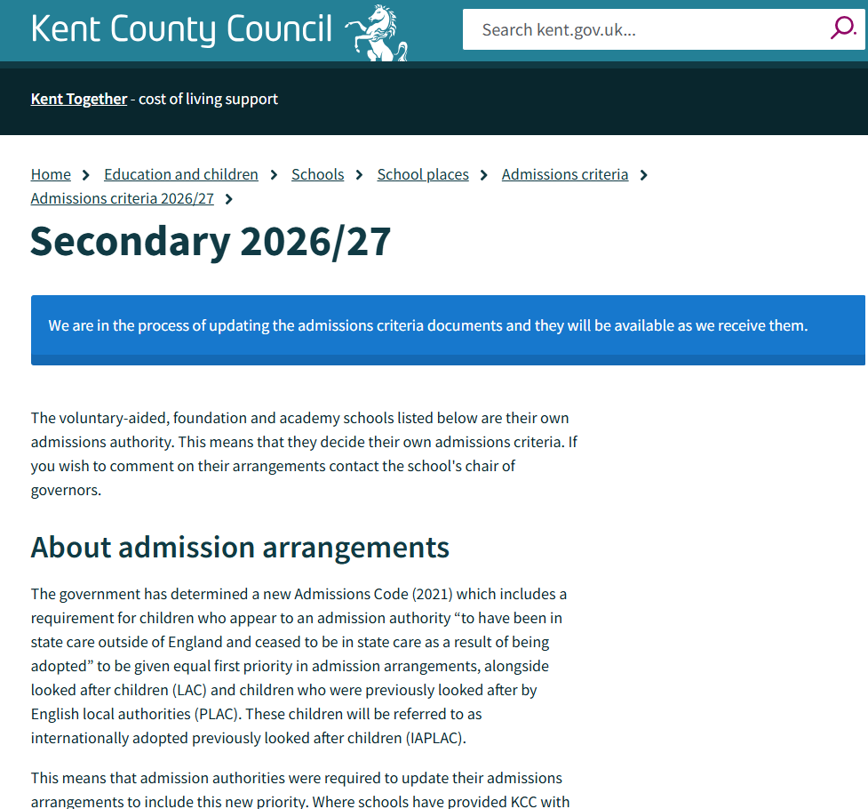

Slide 6
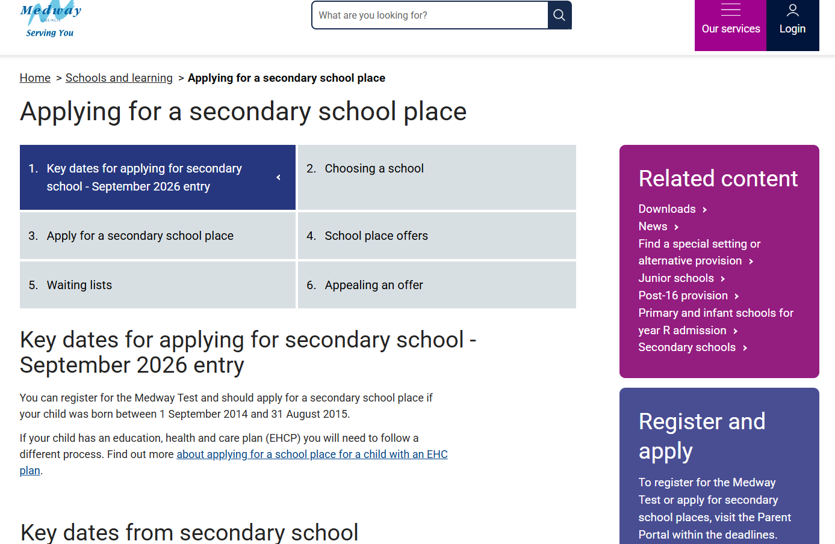

Slide 7
Kent Secondary Common Application Form (SCAF)
Application form opens: Monday 1 September 2025
Application form closes: Friday 31 October 2025
Medway Secondary Common Application Form (SCAF)
Application form opens: Monday 1 September 2025
Application form closes: Friday 31 October 2025

Slide 8
Secondary schools:
Every secondary school has an open evening tour between 2nd September 2025 and 17 October 2025.
‘You can apply for up to 4 schools (Kent) and up to 6 schools (Medway), putting them in order of preference. It's in your best interests to list 4 / 6 schools. Naming only one school does not guarantee your child a place at that school or give your child priority for a place over another child, neither does naming a school more than once’.
Choose 4 secondary schools (Kent residents), 6 secondary schools (Medway residents)
Put favourite school first (this affects appeal process)
If possible put a local secondary on your list
If not passed 11+ and plan to appeal ensure Grammar school is on the form (does not matter where – do not put as first choice! You will not be allocated)

Slide 9
Warning!!!
When you receive your offer of a secondary school on 2 March 2026 you MUST accept this offer…
You can always decline at a later date even up to 31 August 2026. If not accepted on appeal or waiting lists you cannot get it back if things go wrong. Better to have something than nothing!

