Slide 1


Welcome to Owls class
Our teacher is Miss Davey.
Mrs. French, Miss Irvine and Mrs. Reece are our class TAs.

Slide 2
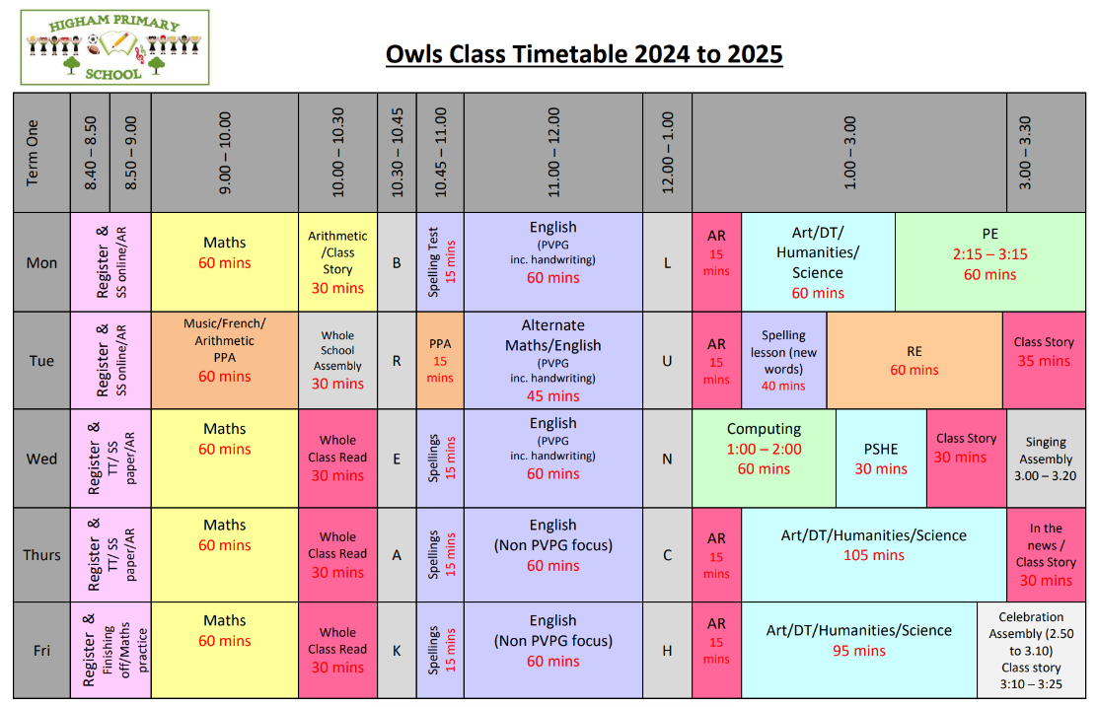
Timetable of the Day

Slide 3
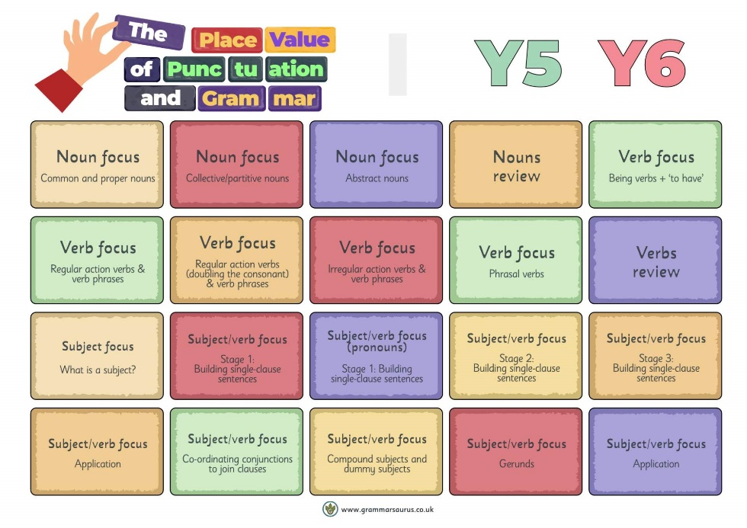
English
In English, we will focus on:
Developing a secure understanding of key grammatical concepts. This will be covered through the use of Grammarsaurus Place Value of Punctuation and Grammar (PVPG). This will form the majority of our English in term one with 3 lessons per week being used to teach the PVPG objectives. The remaining 2 lessons will have a writing focus and will either use standalone texts or will make links to our learning in other subjects such as history and science.

Slide 4
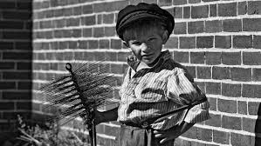
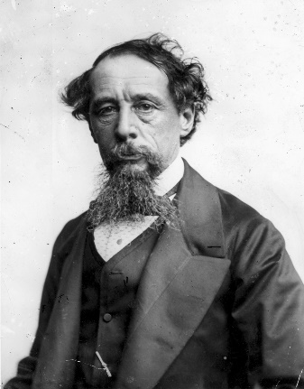
English
We will learn how Doctor Thomas Barnardo changed the lives of homeless street children by setting up his ragged schools and orphanages. We will find out about the different jobs working Victorian children did and will use this knowledge to structure opinion pieces.
Using ‘Who was Charles Dickens?’ by Pamela Pollack and ‘Charles Dickens’ by Catherine Wells-Cole, we will learn about Dickens and will structure our own biography of his life and work. We will use a range of non-fiction texts to research and present information about the Victorian era, the industrial revolution and key inventions which changed the way Victorians lived.

Slide 5
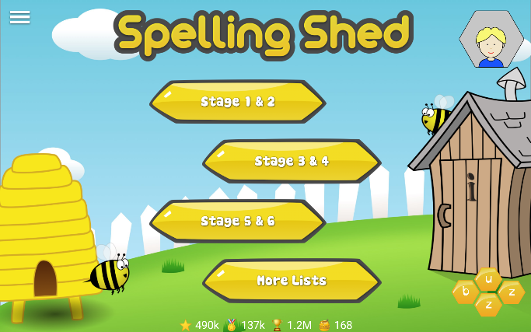

English - Spellings
This year, Owls class will be using Spelling Shed as their spelling programme. They will have a 30 minute lesson every Tuesday which will focus on a spelling rule or pattern, followed by daily spelling activities linked to the spelling rule or pattern being studied. ​
There will be a weekly spelling test every Monday. A list of the spelling rules/patterns which we will study during the term is available on the class page of the school website for your information.​
Pupils all have a Spelling Shed account and will have access to the online games which will support them in strengthening their recall.

Slide 6


Accelerated Reader
Please sign up to HOME CONNECT using the link provided on the letter which was sent home in week one. If you need another copy, let us know.
Please enable “Email Notifications” so you can see how your child scores on their quizzes.
All pupils need to bring in their AR book and reading record every day. We have time dedicated to reading every day.

Slide 7


Maths
Maths homework is not formally set. However, all children are encouraged to practise their times tables recall using TT Rockstars.
Optional SATs Homework
From Spring term onwards, there will be optional weekly maths and English homework to help year six pupils prepare for their SATs test in May. The homework will include test-style questions and will enable them to revise their understanding of work covered in years three to five, as well as new knowledge gained during year six. More details will be given closer to the time.

Slide 8
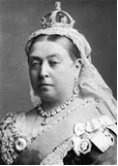

Topics
In term one and two, we will work on our ‘Inventors and Industry’ topic. During this topic work, the class will build upon their knowledge of British history through an in depth study of the Victorian era with a focus on Higham and its most famous resident – Charles Dickens. They will look at how the village has changed over time and what our school would have been like when first built. They will describe the ways of life for different classes of society from the Royal family to life in the workhouses and will find out how Britain changed throughout Queen Victoria’s reign. There will also be the chance to find out about some key inventions of the Victorian era and how they are still significant now.

Slide 9

Topics
Our science work this term looks at light.
In this unit of work, the children will explore the way that light behaves, including light sources, how light travels, laws of reflection and shadows.
They will develop their observational skills in order to talk about what happens and make predictions.
They will also learn about the functions of different parts of the eye.

Slide 10

PE
Our PE day this year is Monday. Should this need to be changed, you will be notified in advance.
Please make sure your child is wearing the correct PE kit:
T-shirt in house colour (Twist, Copperfield, Peggotty or Pip)
Fleece in house colour or black hoodie
PE shorts in green/black
Jog bottoms or legging in black only
No logos on any items of clothing- please wear plain black only.

Slide 11

External tests
Children in year six will sit the Key Stage 2 statutory tests (often called SATs). The dates of these are set by the government.
The statutory key stage 2 tests are timetabled from Monday 12 May to Thursday 15 May 2025.
During SATs week, we offer a breakfast club which we encourage all year six children to come along to. This will be free of charge and will give the children the opportunity to support each other in the run up to the test, help alleviate anxiety and enable children to be in school and ready for the tests each day. More details will be sent out closer to the time.

Slide 12

What they need to bring each day
Reading book and Reading Record Book (yellow A5 book)
Named water bottle
All clothing named clearly
Snack in a named pot
Fresh fruit – prepared and ready to eat
Fresh vegetables – prepared and ready to eat
Plain breadsticks (nut / sesame seed free) – out of their wrapper and in a named snack pot.
Pitta bread or other bread – out of their wrapper and in a named snack pot.

Slide 13

How to support your child at home
Helping with homework – please support your child to practise their times tables using TT Rockstars and their Spelling Shed spelling words.
The importance of hearing your child read, even when they are an independent reader, cannot be overstated. Reading aloud helps to develop an understanding of appropriate tone and volume as well as closely observing punctuation in the text. Discussing what they have read helps build the skills of inference, deduction and prediction.
Strengthening reading fluency and comprehension can also have a positive impact on writing. Reading and writing draw upon the same skills, knowledge, and processes in terms of being able to read and comprehend text and in terms of being able to write text. Another way of thinking about this is that when you write — if you're doing it the right way — you have to think about your reader.

Slide 14
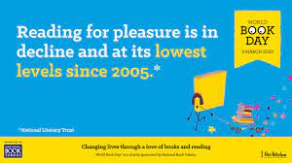
The survey of 71,400 children and young people by the National Literacy Trust early in 2023 has revealed that fewer than one in three children (28%) aged eight to 18 read daily for enjoyment. While this remains the same as for 2022, the figure stood at 38% when the survey began in 2005, marking a 26% fall in those who read daily.

Slide 15
Why is there a decline in reading for pleasure?
Games and online distractions
Rise in social media
Find books boring
Lack of time
Not being read to from an early age by adults (at home and school)
Seeing reading as a process for learning rather a pleasure activity
  ‘Reading for pleasure' is being confused with 'literacy' by many parents at home who commonly don't realise that the more it's pushed as a school subject, the less likely a child is to choose to do it. In the school environment, the national curriculum focuses on reading skills above reading pleasure. However, when pleasure drives reading, children achieve more.

Slide 16
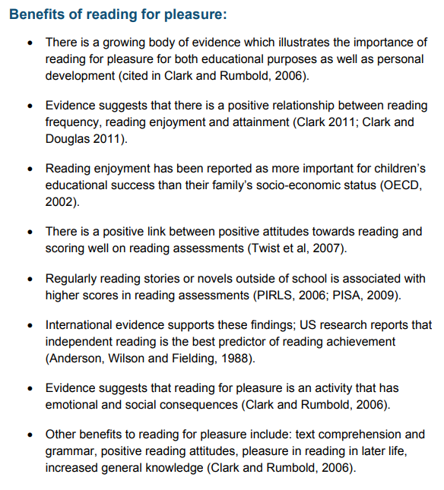
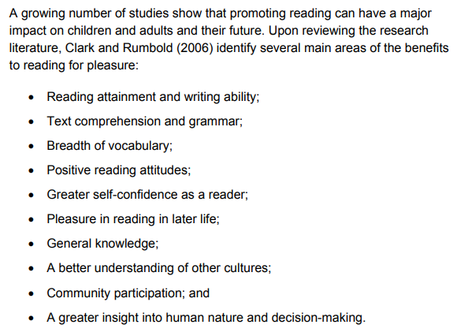




Slide 17
Impact of reading
Amount of reading | 20 mins | 5 mins | 1 min
Number of minutes per year | 3600 | 900 | 180
Number of words per year | 1.8 Million | 282,000 | 8000
Hours read by the end of primary school | 851 | 212 | 42
Performance on tests | 90% | 50% | 10%

Slide 18
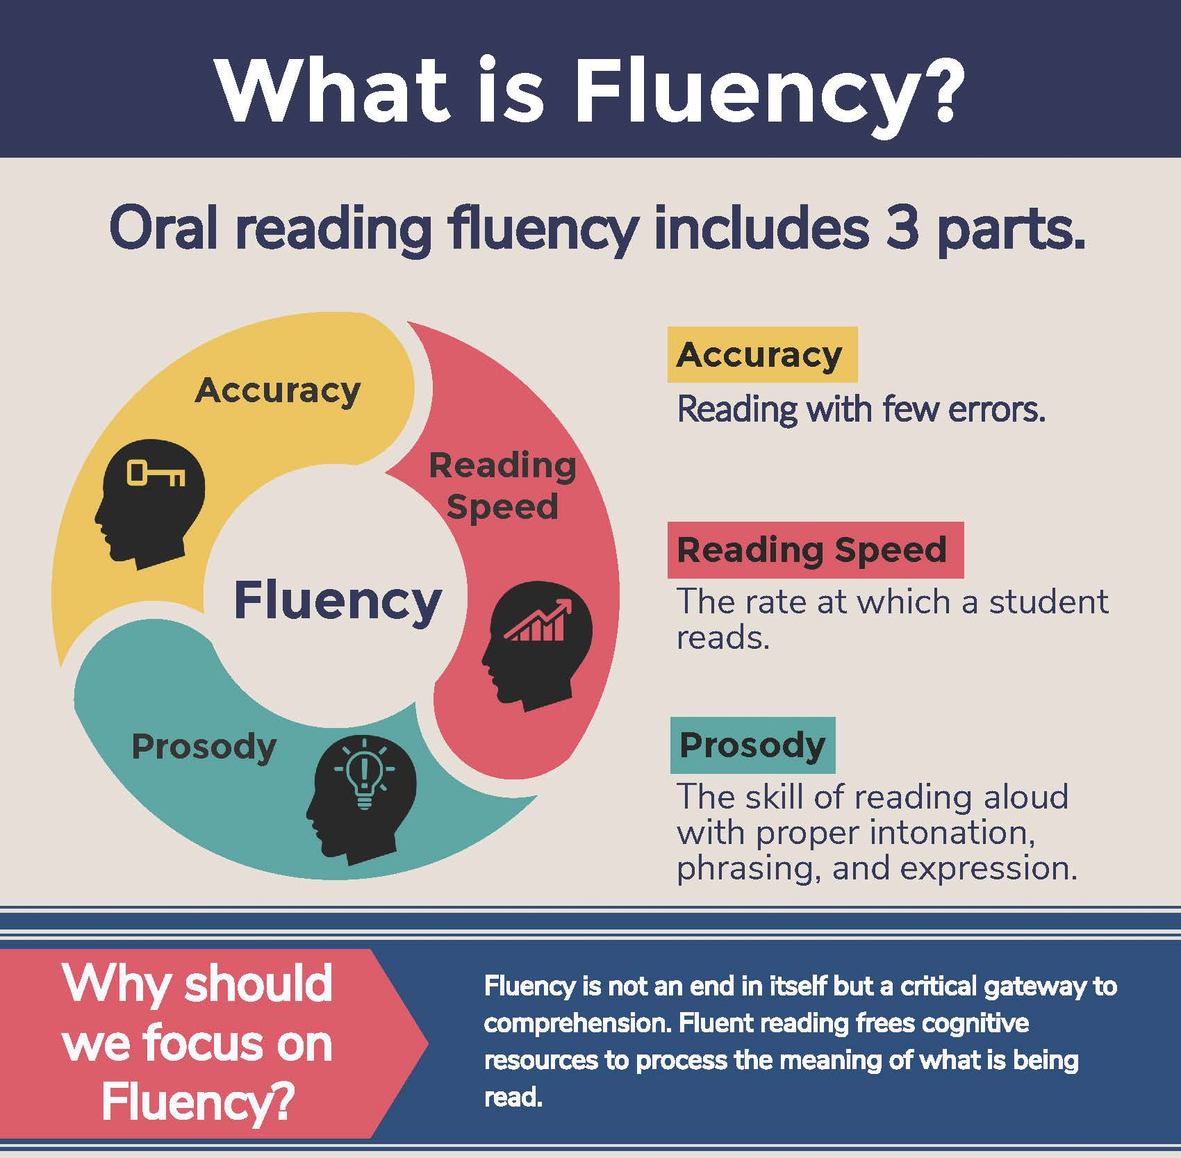
What is fluency and why is it important?
Fluent reading supports reading comprehension. When pupils read fluently, their cognitive resources can be redirected from focusing on decoding and onto comprehending the text. For this reason, fluency is sometimes described as a bridge from word recognition to comprehension.
Basically, if the brain’s processing power isn’t being used up by working out how to read a word, it can concentrate on understanding and enjoying the text.

Slide 19
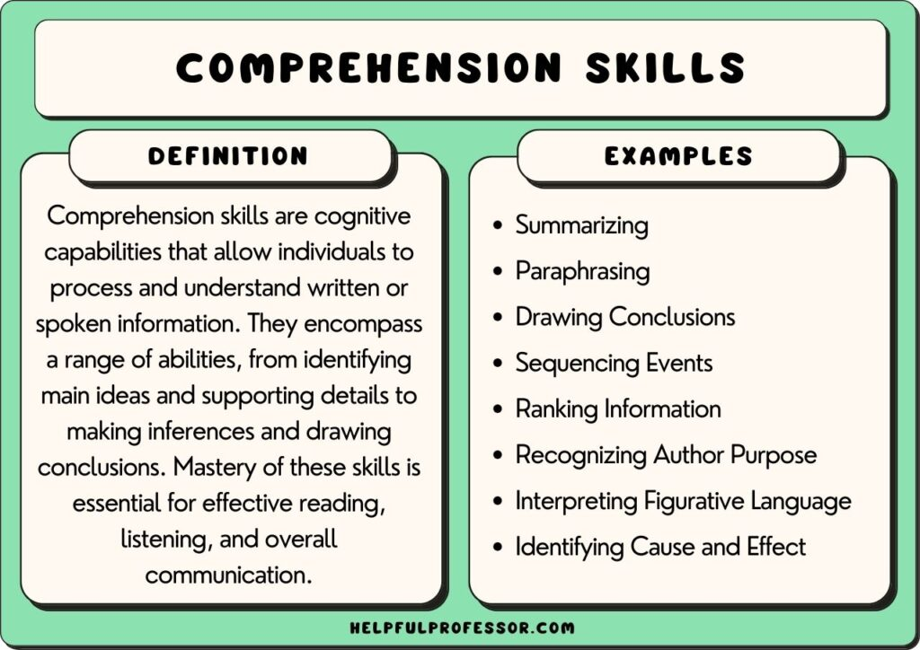
What is comprehension?
This refers to the understanding of a text.
There are cases of where children are able to read thanks to secure phonics knowledge and the ability to decode but do not understand what they have read.

Slide 20
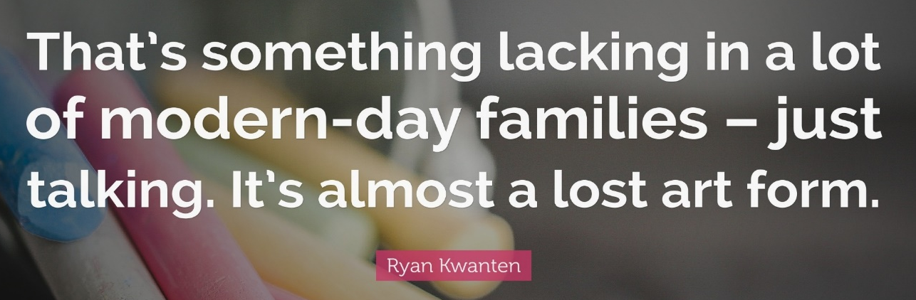
What you can do to help develop comprehension…
Comprehension of the world will develop comprehension in reading…
Ways you can develop comprehension –
  Talking a lot at home… about everything
  Develop cultural capital by going out (this does not have to cost money)
  Reading together and discussing books together
    Why do you like this book?
    What do you think will happen next?
    What do you think about this character?

Slide 21
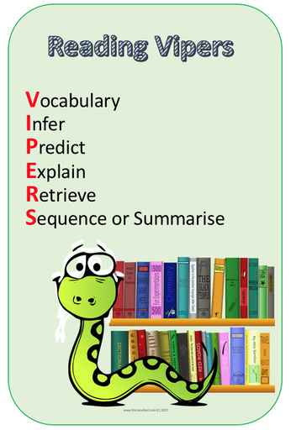
What are the key skills needed to demonstrate secure comprehension?

Slide 22
Vocabulary -
Interpreting words in context and deciphering the meaning of words unknown based on the context they are written.
Mr Ali loathes wearing a tie as he finds it uncomfortable.
We may not know the meaning of the word ‘loathe’ here but based on the context and other evidence within the sentence, we can guess it means ‘doesn’t like’. How have I arrived at this conclusion?
Beowulf was incensed by Grendel’s attack and vowed revenge.
We may not know the meaning of the word ‘incensed’ here but we can guess it means ‘angered’. How have I arrived at this conclusion?

Slide 23
Inference: is an interpretation that goes beyond the literal information given and relies on the evidence within the text as well as background knowledge.
The police find a threatening letter addressed to the victim.
We could infer that someone didn’t like that person.
The bike lay on the floor next to her as she held her leg and cried.
We could infer that the girl fell off her bike.
My stomach rumbled as the smell of dinner wafted from the kitchen.
We could infer that this person is hungry.

Slide 24
Predict – what has or what will happen based on information stated or inferred (linked closely to inference). Again, background knowledge here is important.
Beowulf snatched his sword from the armoury and ran towards the mountains.
  What do predict Beowulf is going to do? What evidence have you used to make your prediction?
Mr Ali woke up with a terrible headache and severe cough. He picked up his mobile and began to dial.
  Who do you think Mr Ali is going to call? Why?
Predictions, like inferences are neither right or wrong, they may be strong (with secure evidence to back them up) or weak (with little or poor evidence to back them up).

Slide 25
Explain –
Identify/explain how information/narrative content is related and contributes to the meaning as a whole.
Identify/explain how meaning is enhanced through choice of words and phrases.
Make comparisons within the text.
***See handout for example questions***

Slide 26
Retrieve
Retrieval of information is often the starting point for discussing a text. This means picking the exact (spelling and punctuation too) information out of the text that they have just read. E.g.
What was the character’s name?
What did they eat for dinner?
What colour was the car?
What time did…
Summary -
Summarise main ideas from more than one paragraph
  What is the main point of the first paragraph?
  What heading would be appropriate for this paragraph?

Slide 27
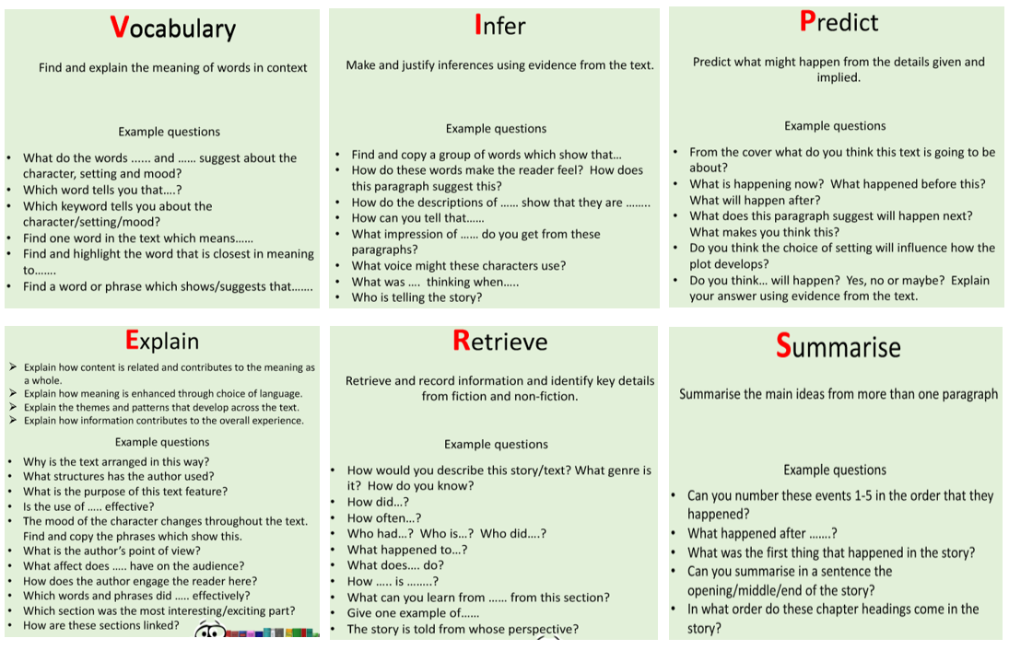
Questions you can ask at home…

Slide 28
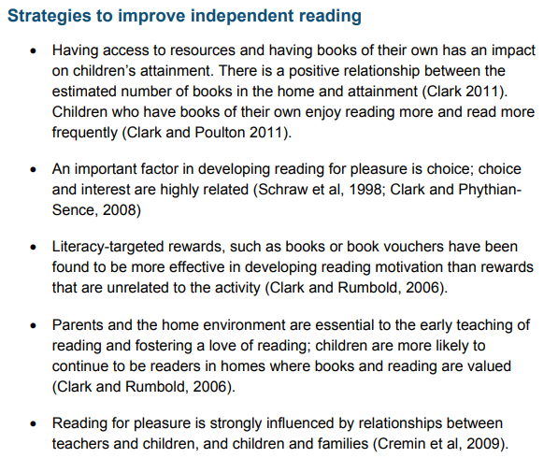
How to encourage independent reading at home
Having books that the child owns
Using the library to help build variety
Exposing children to texts beyond novel. E.g. comics, magazines, non-fiction books
Taking control of screens – reading first and then screentime
Show that you love reading… even if you have to fake it
Give children books that matter to them (BAME authors and characters, texts that excite them)
Reward reading through extrinsic and intrinsic motivators

Slide 29
Thank you for coming.
Do feel free to ask questions.
Alternatively, an email can be sent to the school office who will pass on any queries.
This presentation will be available on the Owls class page of the school website.

