Slide 1



Higham Primary School
Secondary Admissions
Information Evening
13.07.23

Slide 2
Choosing a secondary school….
All secondary schools have an opening evening in Term 1.
Some need to be pre-booked so check with the school you would like to visit. Some start as early as 5pm so be prepared and check in advance on their website.
It is good to visit when in Year 5 and when in Year 6.
If you are not sure contact the school.
Look at as many secondary schools as possible so as to make an informed choice.
If your child is SEN always ask to speak to the SENCO to get a feel for what they can offer.
All secondary schools have an open morning in term 1 – These need to be booked in advance directly with the school.
This gives you an idea of the school in action. Alert us if you intend to visit a school and the absence will be authorised.

Slide 3
Key Action | Scheme date
Registration for testing opens | Thursday 1 June 2023
Closing date for registration | Monday 3 July 2023
Application for Secondary Transfer opens | Friday 1 September 2023
Test date for pupils in Kent Primary schools | Thursday 7 September 2023
Test date for pupils not in Kent Primary schools from | Saturday 9 September 2023
Assessment decision sent to parents | Wednesday 18 October 2023
National closing date for application forms | Tuesday 31 October 2023
Final date for acceptance of on time changes to application details | Friday 8 December 2023
National Offer Day: e-mails sent after 4pm | Friday 1 March 2024
Schools send out welcome letters no earlier than | Tuesday 5 March 2024
Deadline for late applications and waiting list requests to be included in the Kent County Council reallocation stage. Also the date by which places should be accepted or declined to schools. | Friday 15 March 2024
Deadline for lodging appeals | Thursday 28 March 2024
Kent County Council to reallocate places that have become available from the schools’ waiting lists. After this point, schools will take back ownership of their waiting lists. | Thursday 25 April 2024
Key Dates….
Kent

Slide 4
Key dates from secondary school admissions 2024
Date | Event
9am on Thursday 1 June 2023 | Registration for the Medway Test (11+) opens.
5pm on Friday 30 June 2023 | Registration for the Medway Test closes.
Tuesday 4 July 2023 | Closing date for special arrangements requests from schools.
9am on Monday 4 September 2023 | Secondary school applications open.
Tuesday 12 and Wednesday 13 September 2023 | Medway Test dates for children who attend Medway primary and junior schools.
Saturday 16 or Sunday 17 September 2023 | Medway Test date for children from non-Medway schools. One day will be allocated to each child who attends a non-Medway primary or junior school.
Tuesday 3 October 2023 | Results of the Medway Test.
10am on Monday 9 October 2023 | Closing date for receiving Medway Test review requests.
4pm on Tuesday 10 October 2023 | Deadline for primary and junior schools to submit review work to Medway Council.
Thursday 12 October 2023 | Medway Test school work reviews.
Friday 20 October 2023 | Review decisions posted to parents and carers.
5pm on Tuesday 31 October 2023 | Secondary school applications close.
Friday 1 March 2024 | Offers sent to parents and carers.
Thursday 28 March 2024 | Deadline for accepting/refusing offers, waiting requests and appeal requests.
Monday 22 April 2024 | Re-allocation of school places and processing of late applications.
Key Dates…
Medway

Slide 5
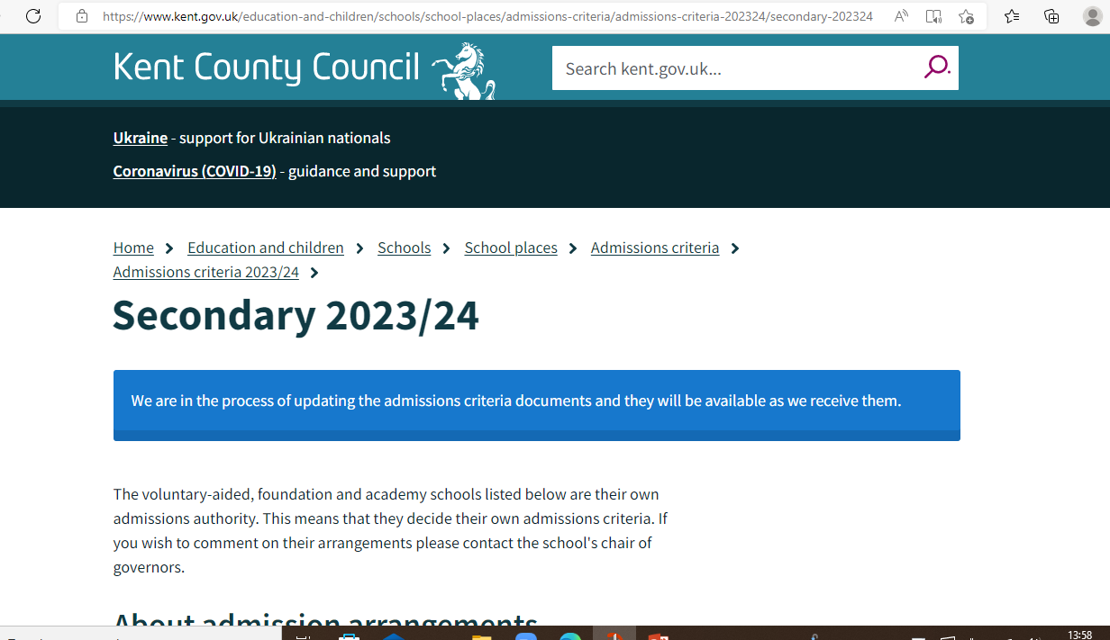

Slide 6
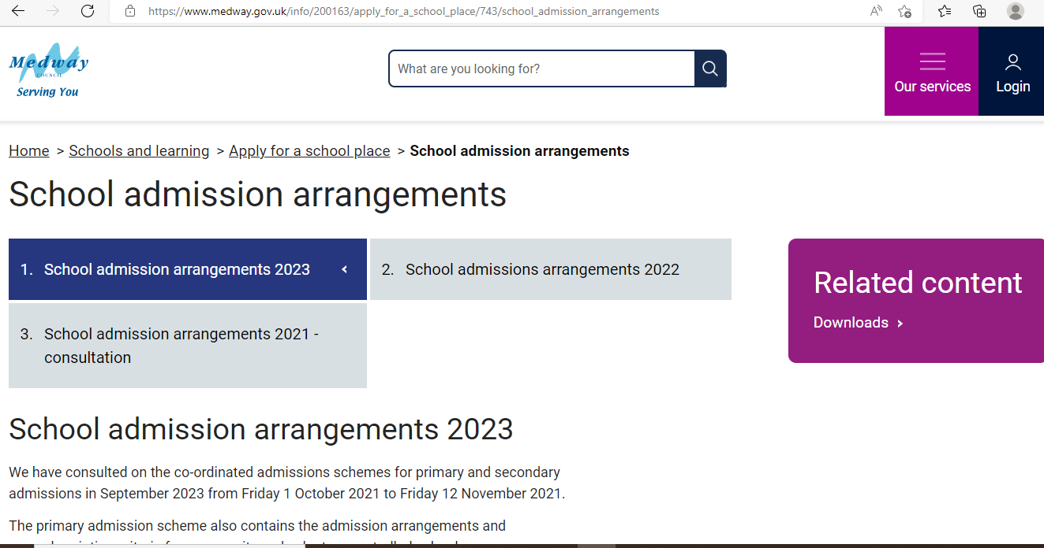

Slide 7
Kent Secondary Common Application Form (SCAF)
https://www.kent.gov.uk/education-and-children/schools/school-places/secondary-school-places
Application form opens: Friday 1 September 2023
Application form closes: Tuesday 31 October 2023
Medway Secondary Common Application Form (SCAF)
https://www.medway.gov.uk/info/200163/apply_for_a_school_place
Application form opens: Monday 4 September 2023
Application form closes: Tuesday 31 October 2023

Slide 8
Secondary schools:
Every secondary school has an open evening tour between 1st September 2023 and 20 October 2023.
‘You can apply for up to 4 schools (Kent) and up to 6 schools (Medway), putting them in order of preference. It's in your best interests to list 4 / 6 schools. Naming only one school does not guarantee your child a place at that school or give your child priority for a place over another child, neither does naming a school more than once’.
Choose 4 secondary schools (Kent residents), 6 secondary schools (Medway residents)
Put favourite school first (this affects appeal process)
If possible put a local secondary on your list
If not passed 11+ and plan to appeal ensure Grammar school is on the form (does not matter where – do not put as first choice! You will not be allocated)

Slide 9
Warning!!!
When you receive your offer of a secondary school on 1 March 2024 you MUST accept this offer…
You can always decline at a later date even up to 31 August 2024. If not accepted on appeal or waiting lists you cannot get it back if things go wrong. Better to have something than nothing!

