Slide 1


Welcome to Foxes Class
Your teacher is Miss Hipkiss
Your teaching assistant is Mrs Morton
We also have Mrs Foster 1:1

Slide 2
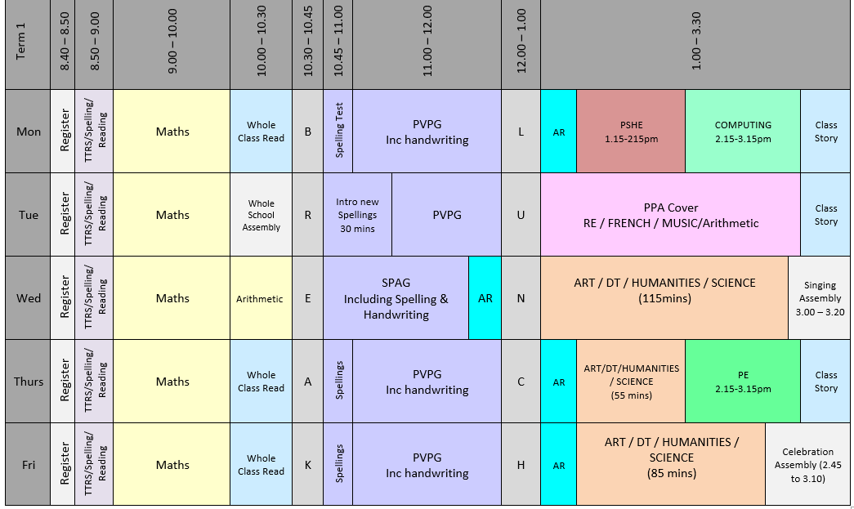
Timetable of the Day
Children need to be in class and ready for 8:50

Slide 3
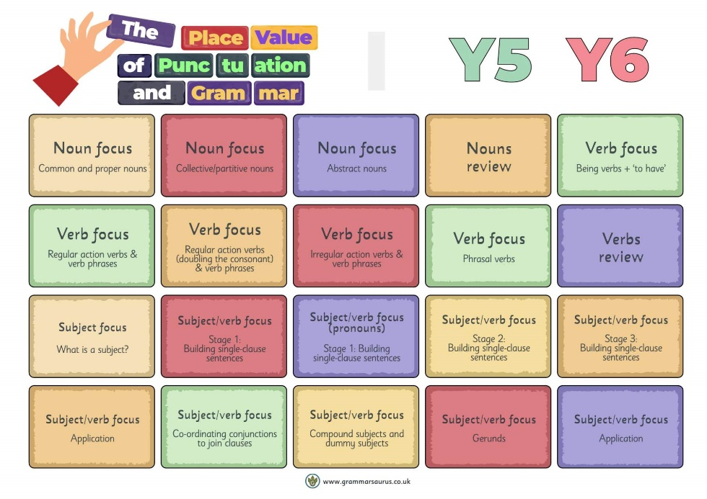
English
In Term 1 we will focus on:
Developing a secure understanding of key grammatical concepts. This will be covered through the use of Grammarsaurus Place Value of Punctuation and Grammar (PVPG).
Handwriting in joined, legible style.

Slide 4


Accelerated Reader
Please sign up to HOME CONNECT using the link provided on the letter which was sent home in week one. If you need another copy, let us know.
Please enable “Email Notifications” so you can see how your child scores on their quizzes.
All pupils need to bring in their AR book and reading record every day. We have time dedicated to reading every day.

Slide 5
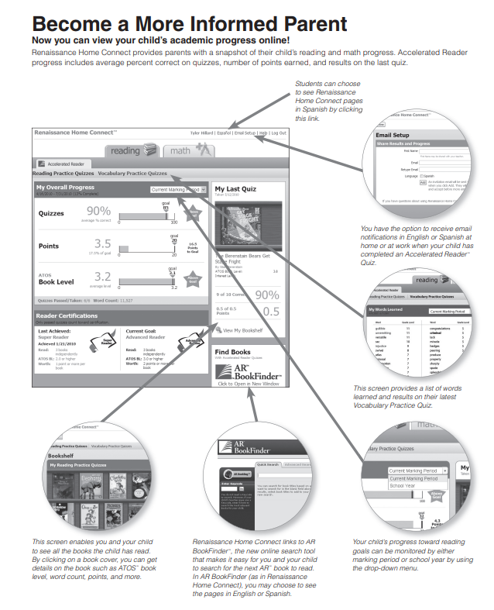
Accelerated Reader
Home Connect – It tells you:
How they got on in quizzes
How many points they have
Their book level
How they are progressing towards their targets

Slide 6
Impact of Reading
Amount of reading | 20 mins | 5 mins | 1 min
Number of minutes per year | 3600 | 900 | 180
Number of words per year | 1.8 Million | 282,000 | 8000
Hours read by the end of primary school | 851 | 212 | 42
Performance on tests | 90% | 50% | 10%

Slide 7
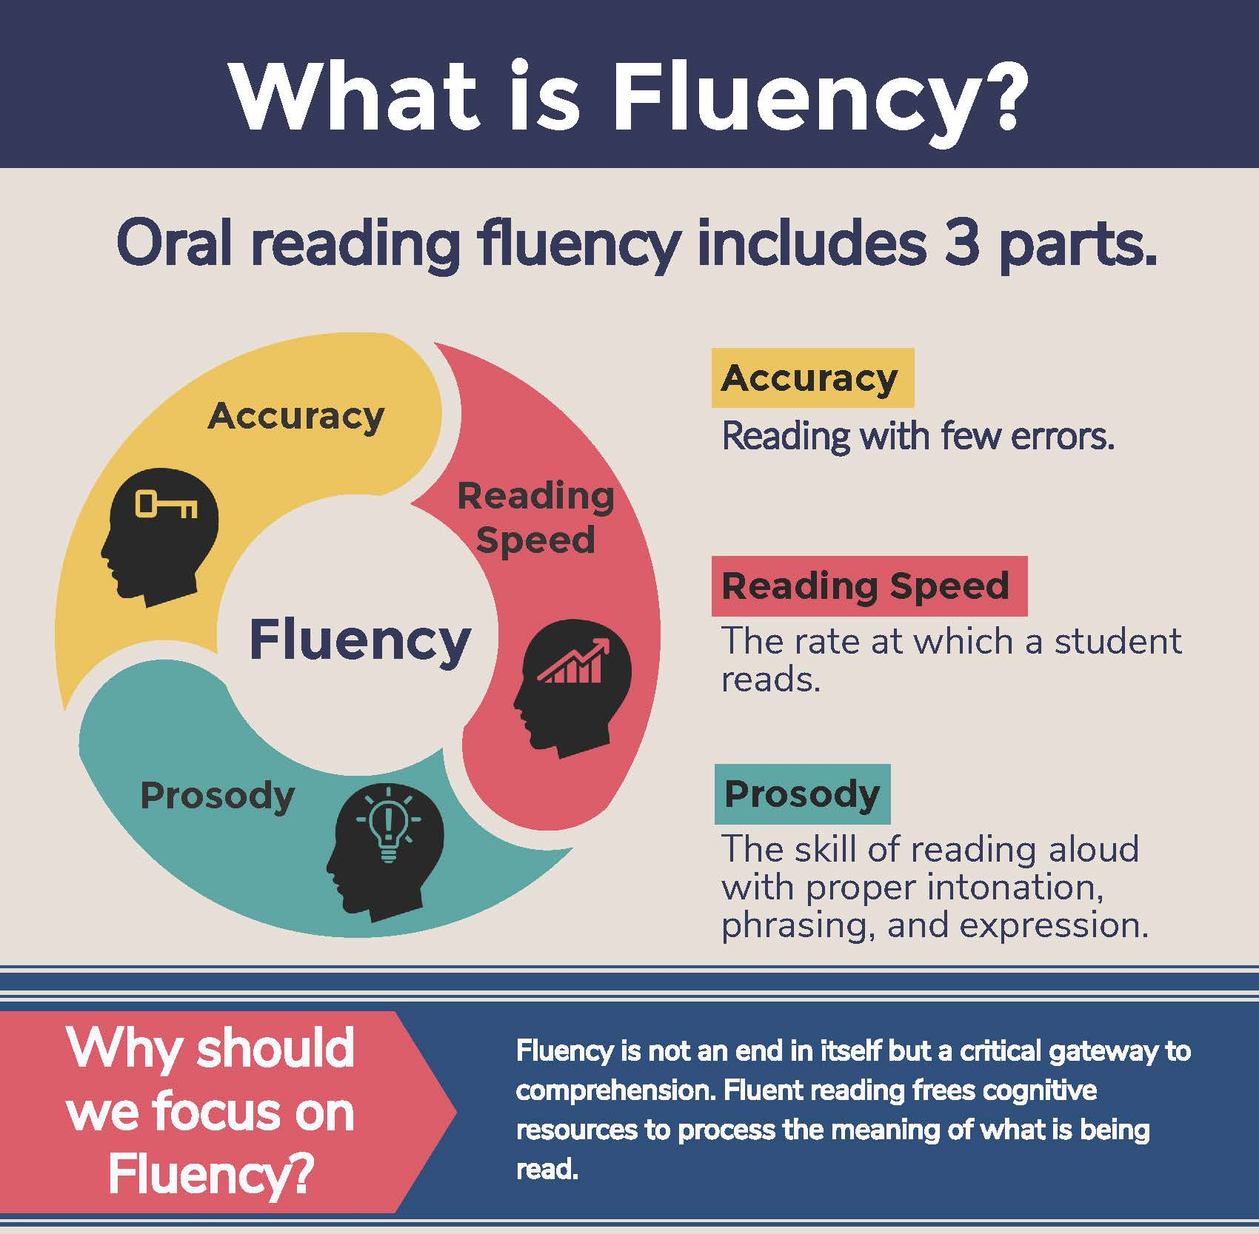
What is fluency and why is it important?
Fluent reading supports reading comprehension. When pupils read fluently, their cognitive resources can be redirected from focusing on decoding and onto comprehending the text. For this reason, fluency is sometimes described as a bridge from word recognition to comprehension.
Basically, if the brain’s processing power isn’t being used up by working out how to read a word, it can concentrate on understanding and enjoying the text.

Slide 8
Three ways you can help build fluency at home…
Read and follow – the adult reads the text and the child follows along with their finger. This helps the child with word recognition and models to them how they should read with fluency.
My turn, your turn – take turns reading a page or a paragraph. Here you are modelling how to read with fluency, flow and expression.
Echo Reading – as you read, the child copies. It is important here to pace yourself and read at a rate that your child can keep up with.

Slide 9
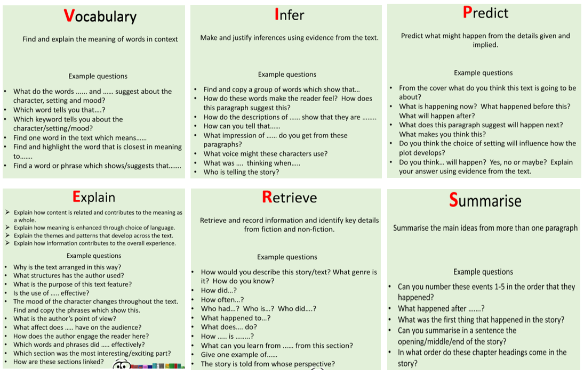
Questions you can ask at home…
What is comprehension?
This refers to the understanding of a text.
There are cases of where children are able to read thanks to secure phonics knowledge and the ability to decode but do not understand what they have read.

Slide 10
What you can do to help develop comprehension…
Comprehension of the world will develop comprehension in reading…
Ways you can develop comprehension –
  Talking a lot at home… about everything
  Develop cultural capital by going out (this does not have to cost money)
  Reading together and discussing books together
    Why do you like this book?
    What do you think will happen next?
    What do you think about this character?

Slide 11

English - Spellings
This year, we will be using Spelling Shed to teach and practice spellings. They will have a 30 minute lesson every Tuesday which will focus on a spelling rule or pattern, followed by daily spelling activities linked to the spelling rule or pattern being studied. ​
There will be a weekly spelling test every Monday. A list of the spelling rules/patterns which we will study during the term will be made available on the class page of the school website for your information.​
Pupils will all have a Spelling Shed account and will have access to the online games which will support them in strengthening their recall.
A Parent Guide is available here: https://play.edshed.com/en-gb/login

Slide 12
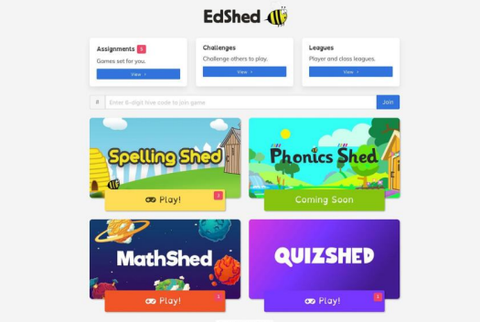
Pupils can log in using the username and password and it will take you to this screen. You do not need to buy the app. You can use spelling shed FREE on a web browser.
The pink notification boxes indicate how many assignments have been set by the teacher and on which game.
If you click on the assignments box at the top of the menu, you can see all of the assignments together.

Slide 13
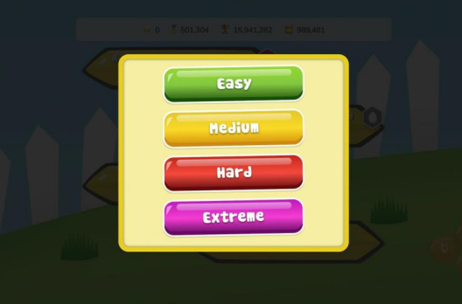
Play
When you click ‘Play’, four difficulty options will appear.
Easy - You will be shown the word as well as hearing it and you will only see the letters you need to spell it.
Medium - You can listen to the word and you will only have the letters you need.
Hard - You can listen to the word but you will have a few extra letters added
Extreme - You will hear the word and you have a full keyboard of letters
These levels of difficulty apply to solo and hive games. Games completed on easier levels will give the player a lower score and lower ranking. The teacher will be able to see which levels have been chosen for each game.

Slide 14

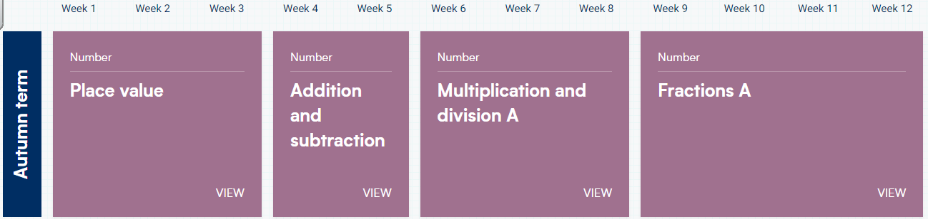
Maths
We use Whiterose for our Maths lessons.
This term we will be looking at place value, addition and subtraction and multiplication.
TT Rock Stars

Slide 15
Topics
Humanities- Awesome Earth
Geography- Looking at the structure of the Earth and natural disasters.
History- Significant natural disasters from the past.
Science- Term 1- Forces, Term 2- Earth and Space
Computing- Internet safety and Systems and Searching
Art- Working with colour, cooking.

Slide 16
Cooking
As part of our DT curriculum, all of the children will get the opportunity to take part in cooking lessons with Mrs Siggers in the kitchen. The children will not all go at the same time and may not cook until the end of the year. The children have been split into groups and each group will attend six sessions across the term. When it is your child’s turn, you will receive a letter with all of the details. In order to cover the cost of the ingredients, we are asking for a contribution of £5 per child. This only needs to be paid when it is your child’s turn. They will also need to bring in a Tupperware box each week to take home their cooking.

Slide 17

PE
Our PE day is Thursday
Please make sure you are wearing the correct PE kit:
T-shirt in house colour (Twist, Copperfield, Peggotty or Pip)
Fleece in house colour or black hoodie
PE shorts in green/black
Jogging bottoms or leggings in black only
No logos on any items of clothing- please wear plain black only.
No earrings to be worn on PE days OR your child must be able to take them out themselves and have a pot to keep them safe.
(PE bag not required)

Slide 18
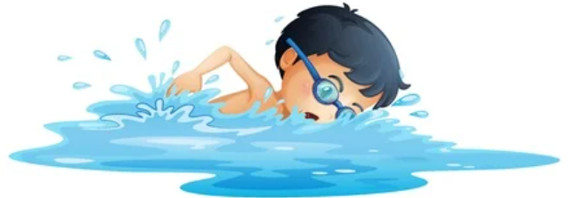
Swimming
Term 3
Friday mornings- this will be our weekly PE lesson
Children will need to be in school at 8.20 on PE days
Part of the National Curriculum
This is a top-up from Year 4
Free of charge

Slide 19
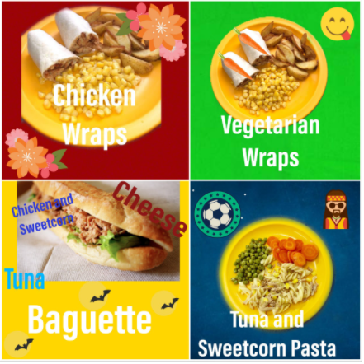
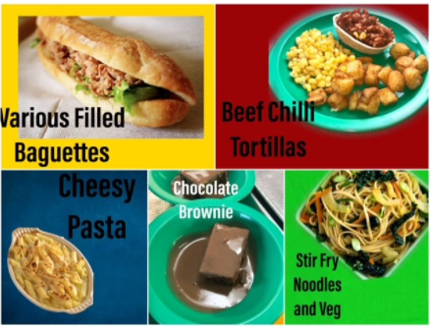
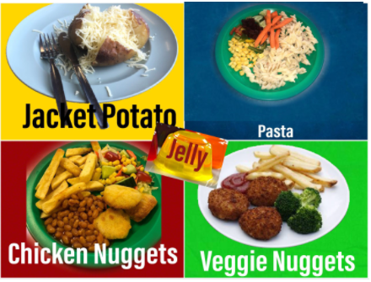
Lunch
Please order your child’s lunch via Bromcom .
Menus are on the school website

Slide 20
How to support your child at home
Helping with homework
Hearing them read
Encourage them to use Times Tables Rock Stars for at least 10 minutes per week
Encourage them to use Spelling Shed for at least 10 minutes per week and to learn spellings for weekly test.
Lots of useful information on the School Website

Slide 21
What they need to bring each day
Reading book and Reading Record Book
Named Water bottle
All clothing named
Snack in a named pot
Fresh fruit – prepared and ready to eat
Fresh vegetables – prepared and ready to eat
Plain breadsticks (nut / sesame seed free) – out of their wrapper and in a named snack pot.
Pitta bread or other bread – out of their wrapper and in a named snack pot.
Spelling book
Please could you provide your child with an apron for our art activities.

Slide 22
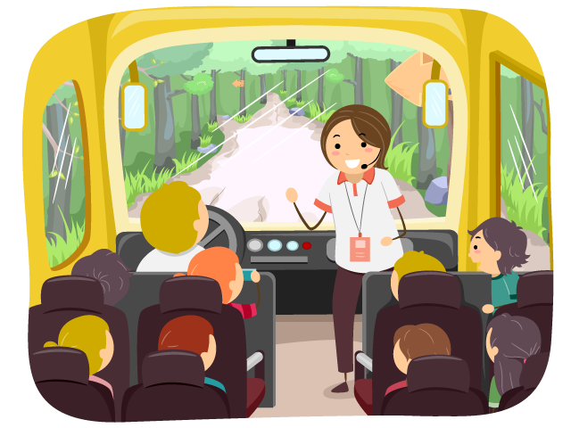
School Trips and Events
Rochester Cathedral
Greek Day- Term 3/4
PGL- Term 5
Horton Kirby- Term 6
A voluntary contribution will be required from all parents for the trips to go ahead, further details nearer the time.

Slide 23
Thank you for coming
Any questions?
If you need to contact me, I will be available at the end of the school day (apart from Wednesdays) or email the school office.

