Slide 1

Year 4 Multiplication Tables Check 2025 Presentation for Parents & Guardians

Slide 2
Why are times tables so important?
In primary school, times tables knowledge is vital for quick mental maths calculations and problem solving, as well as for many topics children learn in KS2 (division, fractions, decimals, percentages)
In secondary school, good multiplication skills are a great help when starting to learn algebra, as well as chemistry, physics, biology and Computing, all of which depend heavily on maths knowledge.
Being fluent in your times tables is essential for success in Mathematics.
Children who can’t recall their times tables struggle in all areas of mathematics, due to cognitive overload.
Automaticity with facts is essential so the mind is free to think about concepts.
Children need to move away from inefficient counting strategies as quickly as possible.

Slide 3
Times Tables Expectations for your child

Slide 4
Important information about multiplication tables check (MTC)
The MTC determines if Year 4 children can fluently recall their multiplication tables.
They are designed to help schools identify which children require more support to learn their times tables.
There is no ‘pass’ rate or threshold which means that, unlike the Phonics Screening Check, children will not be expected to re-sit the check.
The Department for Education (DfE) will create a report about the overall results across all schools in England, not individual schools.
Notes:
The test is designed to identify pupils who need support, not as a diagnostic tool to assess the times tables children struggle with.

Slide 5
When the check will take place
There will be a 2 week window from Monday 2nd June and Friday 13th June 2025 for schools to administer the check.
There is no set day to administer the check and children are not expected to take the check at the same time.
All eligible Year 4 children in England will be required to take the check.
Notes:
It is up to individual schools to decide how the check is administered – some schools will administer individually while others will take small groups out or administer to the whole class.
A list of pupils who should not take the test can be found in the administration guidance of the MTC documentation.

Slide 6
How the check is carried out
The check will be fully digital.
Answers will be entered using on-screen number pad.
Usually, the check will take less than 5 minutes for each child.
The children will have 6 seconds from the time the question appears to input their answer.
There will be a total of 25 questions with a 3 second pause in-between questions.
There will be 3 practice questions before the check begins.
Notes:
Some children will be eligible for additional support (detailed in the next slide).
6 seconds per answer means that children must be able to read, recall and enter their response within that time. Whatever is written in the answer box at the end of 6 seconds will be counted as the answer i.e. if the student intends to write 144 and only 14 is typed when the timer ends, their recorded answer is 14.
Children are allowed to practise before taking the check.
https://mathsframe.co.uk/en/resources/resource/477/Multiplication-Tables-Check example showing how quick the questions are/ types of questions.

Slide 7
The check questions
Each child will be randomly assigned a set of questions
There will only be multiplication questions in the check, not division facts.
The 6, 7, 8, 9 and 12 times tables are more likely to be asked.
Reversal of questions (e.g. 8 x 6 and 6 x 8) will not be asked in the same check.
Children will not see their individual results when they complete the check.
Notes:
Some questions will be repeated across different checks, but no more than 30% of questions will be repeated in any two checks. This means that if the check gets interrupted and children need to re-start it, they will only have a minimal advantage.
During the check pupils may be able to restart if certain conditions are met (e.g. a fire alarm).
The results will be sent to the schools when all the checks have been completed but it is then up to the school if they report the results or not.
There won’t be questions from the 1 times tables (although they might be included in the 3 practice questions).
There will be a maximum of 7 questions from the 2, 5 and 10 times tables.
There is a focus on the 6, 7, 8, 9 and 12 times tables as they are the ‘most difficult’ multiplication tables.

Slide 8
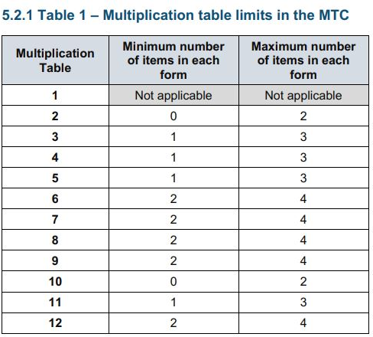
More information about the questions
The Standards and Testing Agency (STA) state that they are classifying the multiplication tables by the first number in the question. For example, 8 x 3 would fall within the 8 times table.
Notes:
The table shows the minimum/ maximum number of questions from each times table that will be asked.

Slide 9
How best to prepare your child for the check
Remind them that the check should last no more than 5 minutes.
If you want to go over times tables, make them fun.
If you have any concerns, talk to your child’s teacher.
If your child has any concerns, encourage them to talk to a trusted adult (for example, yourself, their teacher).
Encourage your child to play TT Rockstars regularly ideally 10-15 minutes a day!
Notes:
Games to try:
Climb the stairs counting in multiples
Play time tables games verbally.
Listen and sing along to times tables songs.
Take it in turns to say times tables in funny voices.
Play maths games online.

Slide 10
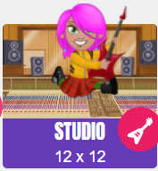
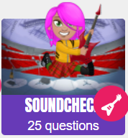
TT Rockstars
Please encourage your child to play TT Rockstars for 10 to 15 minutes a day.
The main activities we would like them to choose between are Studio and Soundcheck.
Studio - Here your child earns their Rock Status, which is based on their Studio Speed. The faster they are the better their status. Studio Speed is the average of their most recent 10 Studio games. Studio tests them on all their times tables up to 12 x 12.
Soundcheck – This is in the style of Multiplication Check that they will be taking in June. Soundcheck games ask 25 multiplication questions (up to 12×12), allowing 6 seconds for each question.

Slide 11
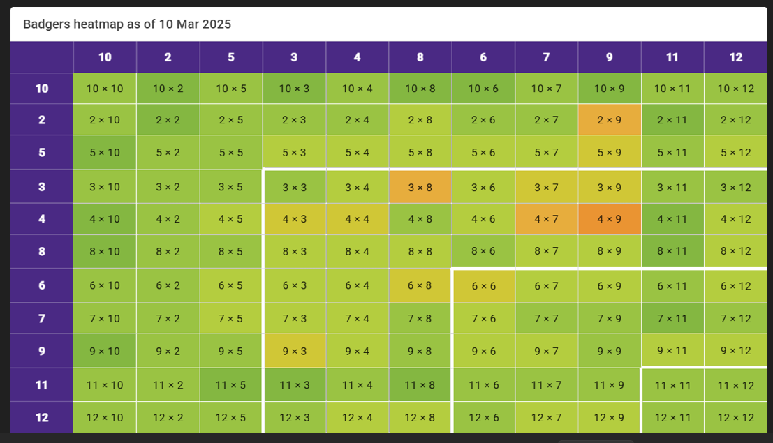

Slide 12


Multiplication is commutative
3 x 2 is the same as 2 x 3
Children need to understand that multiplication can be completed in any order to produce the same answer. Sometimes this link needs to be made explicit.
3 lots of 2 = 6
2 lots of 3 = 6
Notes:
Children build on their existing understanding using arrays, turning the arrays around to show that you now have 2 groups of 3 and they will still total 6. This can then be linked to recalling multiplication facts, e.g. if they know their 2 times table as facts but not their 3 times table, they can use 2 x 3 to work out 3 x 2.

Slide 13
Will I receive feedback on my child’s check?
Yes. Your child’s score will be shared with you as part of their of the end year school report in July. There is no pass mark for the check.

Slide 14
Any Questions

