Slide 1


Welcome to BADGERS class
Your teacher is Mrs Driscoll
Your teaching assistant is Mrs Turner
Miss Chan will also be completing her teacher training with Badgers class this year.

Slide 2
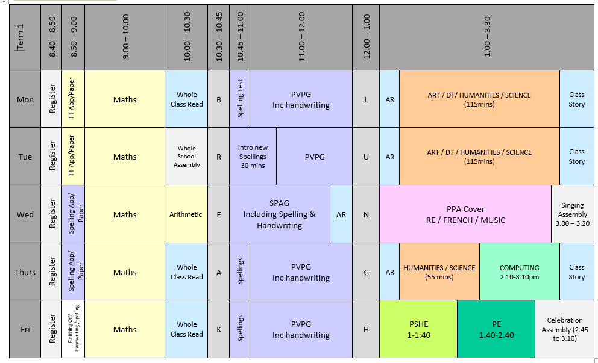
Timetable of the Day
It is really important that pupils are in school promptly in the morning as we do use the first 15 minutes of the day for early work – times table practise and spelling activities.

Slide 3
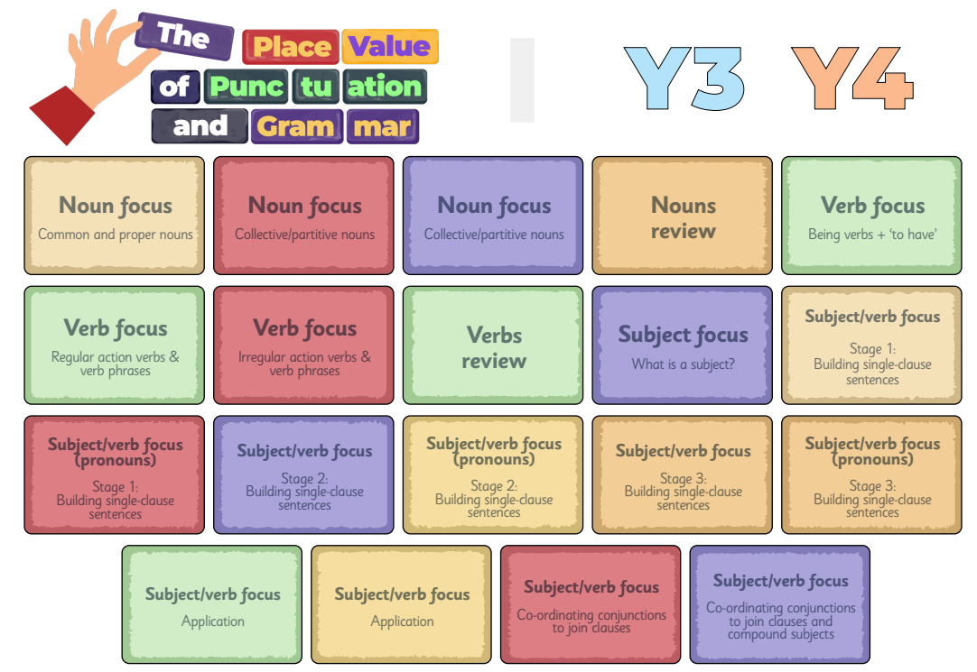
English
In Term 1 we will focus on:
Developing a secure understanding of key grammatical concepts. This will be covered through the use of Grammarsaurus Place Value of Punctuation and Grammar (PVPG).
Handwriting in joined, legible style.

Slide 4


Accelerated Reader
Please sign up to HOME CONNECT using the link provided on the letter which was sent home in week one. If you need another copy, let us know.
Please enable “Email Notifications” so you can see how your child scores on their quizzes.
All pupils need to bring in their AR book and reading record every day as we have dedicated reading time each day.

Slide 5
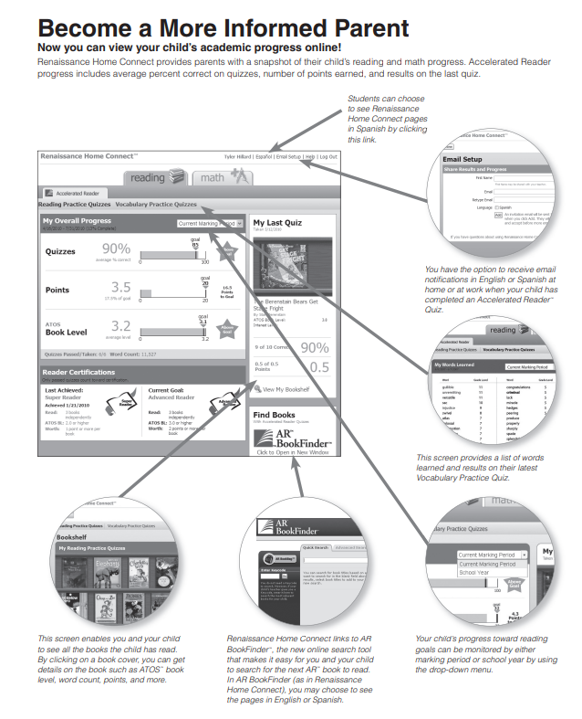
Accelerated Reader
Home Connect – It tells you:
How they got on in quizzes
How many points they have
Their book level
How they are progressing towards their targets

Slide 6
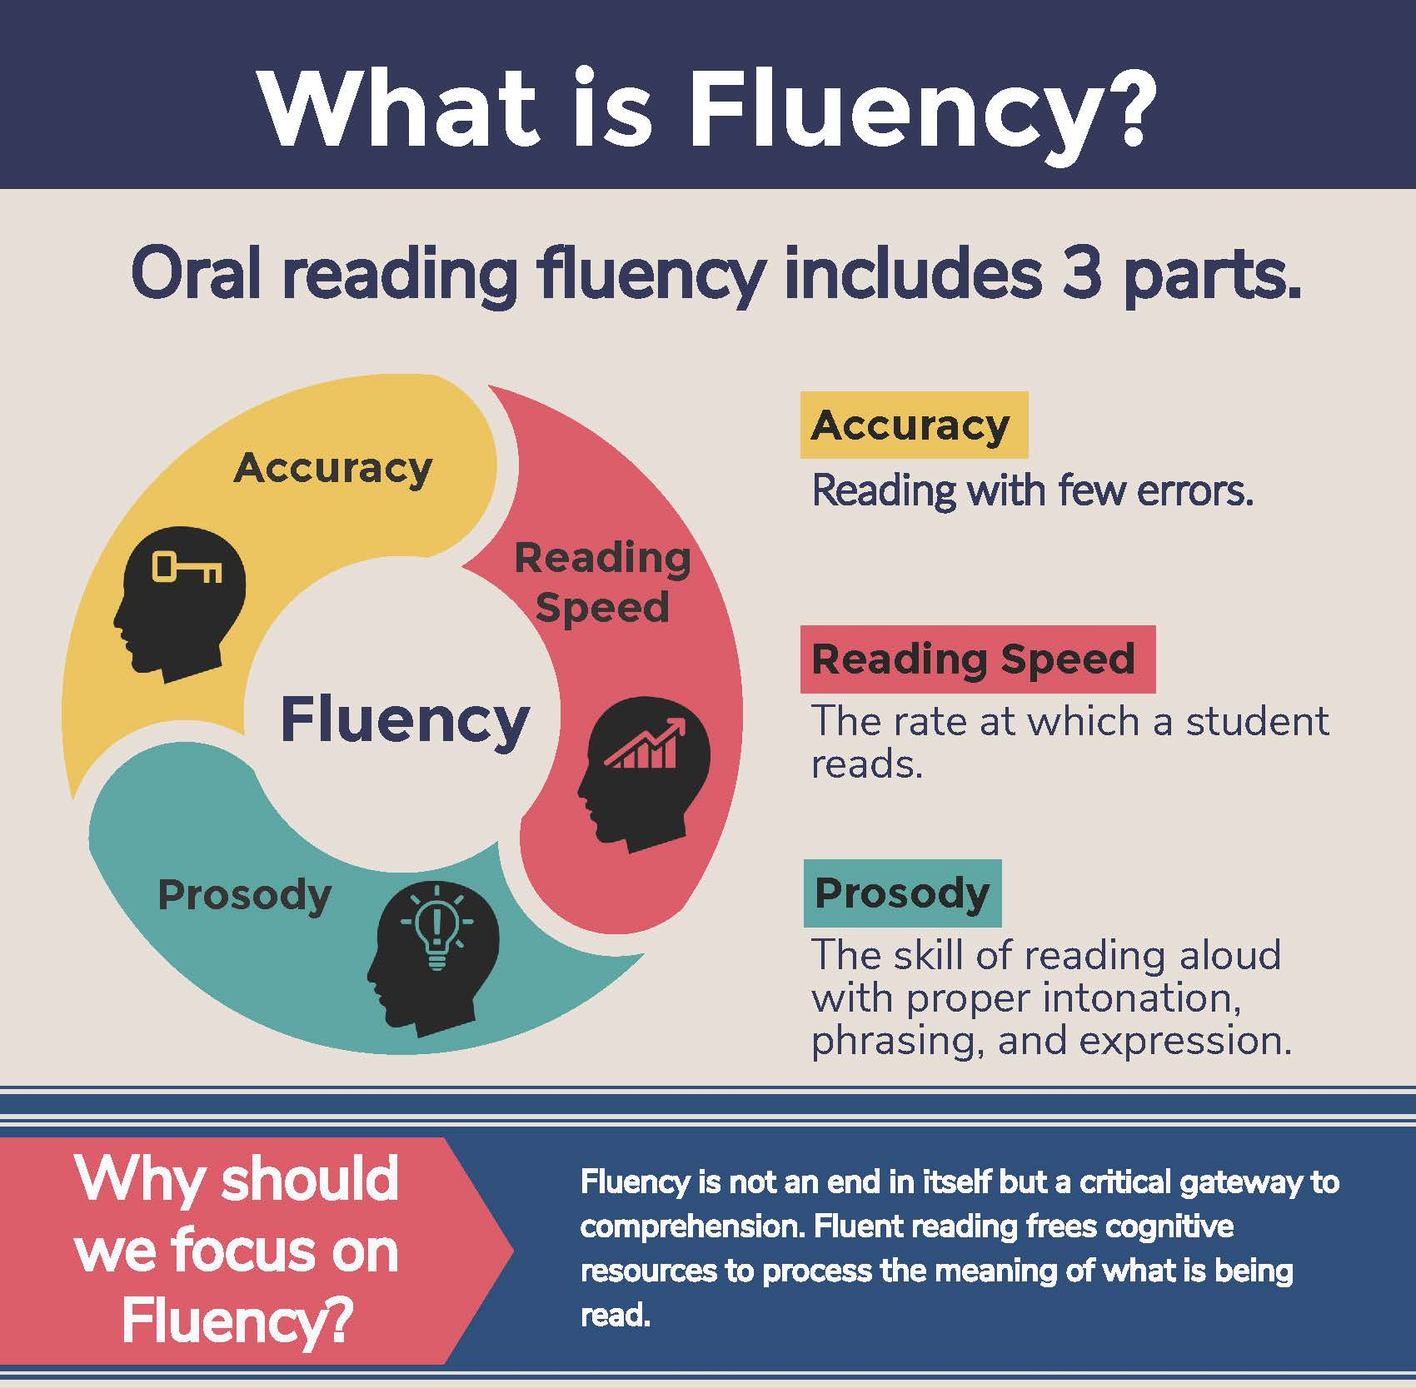
What is fluency and why is it important?
Fluent reading supports reading comprehension. When pupils read fluently, their cognitive resources can be redirected from focusing on decoding and onto comprehending the text. For this reason, fluency is sometimes described as a bridge from word recognition to comprehension.
Basically, if the brain’s processing power isn’t being used up by working out how to read a word, it can concentrate on understanding and enjoying the text.

Slide 7
Three ways you can help build fluency at home…
Read and follow – the adult reads the text and the child follows along with their finger. This helps the child with word recognition and models to them how they should read with fluency.
My turn, your turn – take turns reading a page or a paragraph. Here you are modelling how to read with fluency, flow and expression.
Echo Reading – as you read, the child copies. It is important here to pace yourself and read at a rate that your child can keep up with.

Slide 8
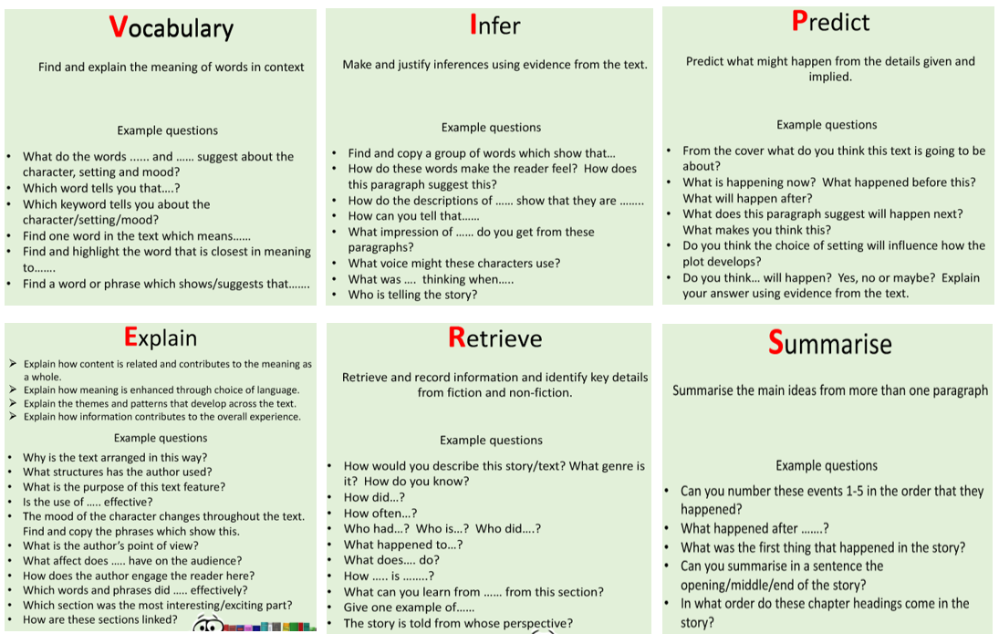
Questions you can ask at home…
What is comprehension?
This refers to the understanding of a text.
There are cases of where children are able to read thanks to secure phonics knowledge and the ability to decode but do not understand what they have read.

Slide 9
What you can do to help develop comprehension…
Comprehension of the world will develop comprehension in reading…
Ways you can develop comprehension –
  Talking a lot at home… about everything
  Develop cultural capital by going out (this does not have to cost money)
  Reading together and discussing books together
    Why do you like this book?
    What do you think will happen next?
    What do you think about this character?

Slide 10

English - Spellings
This year, we will be using Spelling Shed to teach and practice spellings. They will have a 30 minute lesson every Tuesday which will focus on a spelling rule or pattern, followed by daily spelling activities linked to the spelling rule or pattern being studied. ​
There will be a weekly spelling test every Monday. A list of the spelling rules/patterns which we will study during the term will be made available on the class page of the school website for your information.​
Pupils will all have a Spelling Shed account and will have access to the online games which will support them in strengthening their recall.
A Parent Guide is available here: https://play.edshed.com/en-gb/login

Slide 11
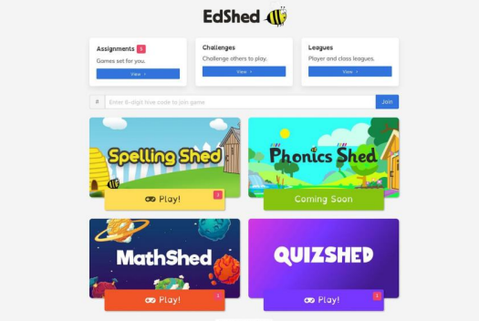
Pupils can log in using the username and password and it will take you to this screen. You do not need to buy the app. You can use spelling shed FREE on a web browser.
The pink notification boxes indicate how many assignments have been set by the teacher and on which game.
If you click on the assignments box at the top of the menu, you can see all of the assignments together.

Slide 12
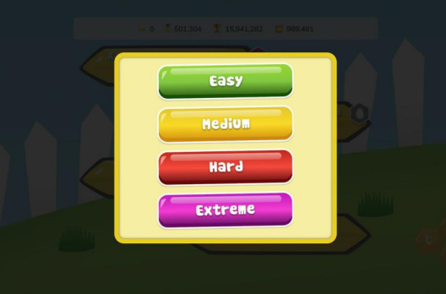
Play
When you click ‘Play’, four difficulty options will appear.
Easy - You will be shown the word as well as hearing it and you will only see the letters you need to spell it.
Medium - You can listen to the word and you will only have the letters you need.
Hard - You can listen to the word but you will have a few extra letters added
Extreme - You will hear the word and you have a full keyboard of letters
These levels of difficulty apply to solo and hive games. Games completed on easier levels will give the player a lower score and lower ranking. The teacher will be able to see which levels have been chosen for each game.

Slide 13

Maths
Children are encouraged to use TT Rock Stars in Year 4 to help them learn their times tables. Login details are in the front of their Reading Record books.
At the moment, please encourage your child to play the Garage games (Practising specific tables at their level) and the Studio (practicing all the times tables and developing their rock speed).
Children will be set specific tasks to complete each week – 5 studio and 5 garage sessions
We will have tournaments across the school year as well, known as Band Battles.

Slide 14
Topics
 | Autumn |  | Spring |  |  | Summer
Humanities | European Adventures (Looking at different countries in Europe) |  | Tomb Raiders (The Ancient Egyptians) |  |  | The Quest for the Kingdom (The Anglo-Saxons and Vikings)
Science | Living things and their habitats | Sound |  | Animals including Humans – digestion & teeth | States of Matter |  | Electricity
DT / Art | Working with colour Textiles - weaving |  | Textiles – Egyptian collars Sculptures – clay and papier mâché |  |  | Structures – pavilions Electrical systems - torches
PE | Basketball Gymnastics |  | Swimming Fitness |  |  | Tennis Athletics

Slide 15

PE
Our PE day is FRIDAY
Please make sure you are wearing the correct PE kit:
T-shirt in house colour (Twist, Copperfield, Peggotty or Pip)
Fleece in house colour or black hoodie
PE shorts in green/black
Jog bottoms or legging in black only
No logos on any items of clothing- please wear plain black only.
Earrings and watches to be removed and hair tied back

Slide 16
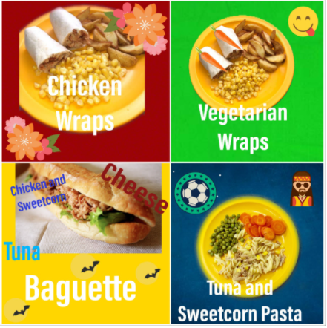
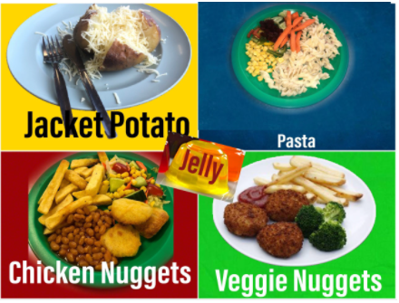
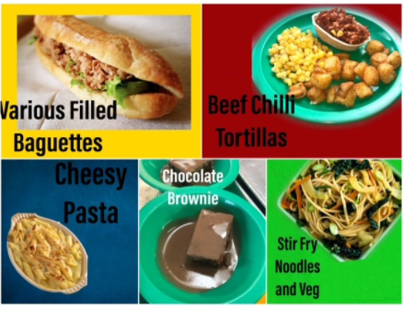
Lunch
Don’t forget to try our tasty school dinners
Menus are available on the school website
Please wherever possible, order you child’s meal in advance on Bromcom as this makes morning registration much quicker

Slide 17

External tests
Yr 4 Multiplication check from 1st – 14th June 2025
- This is a 25 question test, taken on the iPad which covers all times tables up to 12 x 12 – it is a timed test
- It is very similar in format to the Soundcheck feature on TT Rockstars – use this to practise!
- There will be a separate meeting to give you more information about this test in Term 3
There are also three assessment weeks in the year where more formal English and Maths papers are sat

Slide 18
How to support your child at home
Helping with homework – learning spellings (issued every Tuesday) and times tables
Hearing them read regularly and asking them questions about what they have read
Talk to them about school – What new facts did they learn today? What did they find tricky?
Help them find other information / go on visits linked to the topics being studied.
Keep an eye on the school website and Facebook pages for information about the different events in school and for other useful information

Slide 19
What they need to bring each day
AR reading book and yellow reading record book
Named water bottle
Snack in a named pot
Fresh fruit – prepared and ready to eat
Fresh vegetables – prepared and ready to eat
Plain breadsticks (nut / sesame seed free) – out of the wrapper and in a named snack pot.
Pitta bread or other bread – out of the wrapper and in a named snack pot.
* All clothing worn (both PE kit and uniform) should be clearly labelled with the child’s name
* Please DO NOT send children in with their own pencil cases and equipment as this can cause problems in class and we cannot accept responsibility if things get damaged or go missing.

Slide 20
Volunteers
If anyone is able to help in class each week to hear readers, please let myself or the office know (DBS check would be required)
Also, throughout the year, there are some activities that we do in class that are much easier with a few extra pairs of hands eg: sewing and papier-mache so I may put out a request for parent helpers from time to time – please come forward and help!!
Random Request: We will be in need of 30 tall Pringles tubes in Term 4 so if anyone has any tubes between now and then, please send them in and I will store them away safely!

Slide 21
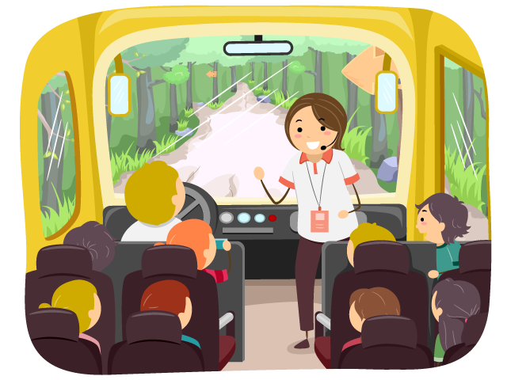
School Trips and Events
School trips and workshops have not been finalised for this year yet, however I will try to give you as much notice as possible.
Swimming takes place for Y4 in the Spring term. We go to Cygnet Leisure Centre each week where the children have a 55-60 minute lesson taught by qualified swimming instructors. Please be aware that there is a cost for this, which is just the cost of the transport to and from the pool, not for the lessons themselves.

Slide 22
Thank-you for coming
Any questions?
Please remember that I am available at the end of the school day or alternatively please send an email to school office if you need to contact me.

